Slide 1
Chapter 1 Introduction to Computers and Programming

Slide 2
Computers & Programming
Impact upon our lives
Cell phones
Education
Automobiles
Planes
Gaming
MP3 players
Health care
…

Slide 3
Computers & Programming
Terms
Computer – electronically powered physical device that has ability to store, manipulate and access data
Program (or software) – specific set of instructions that directs the actions of a computer
Computer system – includes hardware (physical components) and software working together to accomplish a specific task

Slide 4
1.2 Historical Developments
Abacus
Chinese usually credited with inventing it thousands of years ago
Made-up of beads and wires
Charles Babbage
Englishmen - 1791 – 1871
Father of Computing
Analytical Engine included ideas in many computers today including idea of a program

Slide 5
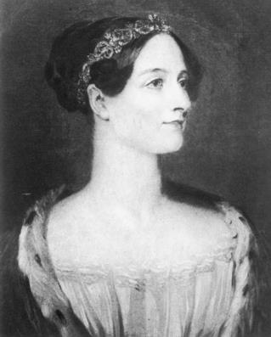
1.2 Historical Developments
Ada Lovelace
Created program for the Analytical Engine
Would have worked if built
Considered first programmer
Ada Lovelace

Slide 6
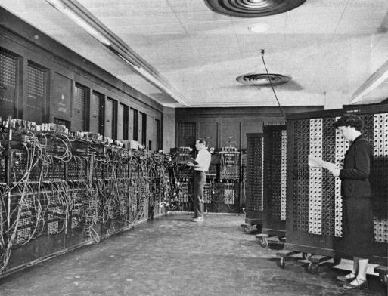
1.2 Historical Developments
ENIAC
Electronic Numerical Integrator and Computer
1940’s
Could be programmed
Size of a room - weighed almost 30 tons
ENIAC

Slide 7
1.2 Historical Developments
Integrated Circuit (IC)
Chip – components include:
Resistors
Transistors
Capacitors
Microprocessor – IC that executes a program
Continue to evolve
Becoming smaller, faster, and cheaper

Slide 8
1.2 Historical Developments
Integrated Circuit (IC) – continued
Often includes a Central Processing Unit (CPU)
Considered ‘brains’ of computer system
Executes instructions
Directs activities and manages hardware components

Slide 9
1.3.1 Input and Output (I/O) Devices
Input Devices
Keyboard
Mouse
Touchscreen
Gamepad
Output Devices
Video Display
Printer
Speaker/Headphone

Slide 10
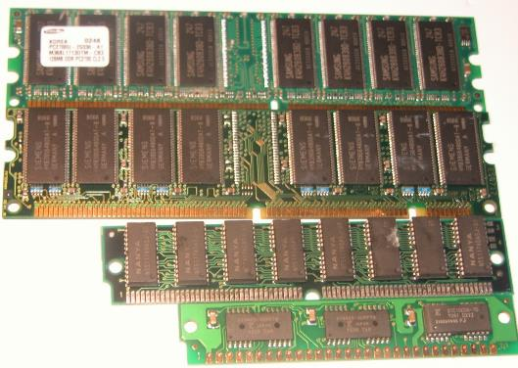
1.3.2 Random Access Memory (RAM)
Short term
Fast
Considered main memory
Holds program and data for processing
Kinds of RAM

Slide 11
1.3.3 Central Processing Unit (CPU)
Brains of the computer system
Interprets and executes instructions
Contained on one microprocessor

Slide 12
1.3.3 Central Processing Unit (CPU)
Central Processing Unit – includes three parts
Arithmetic Logic Unit (ALU)
Arithmetic operations – like add and subtract
Logic – Comparing two values for equality
Control Unit (CU)
Executes instructions
Controls when and what (instructions) to execute
Registers
Fast memory
Holds and stores data being manipulated

Slide 13
1.3.3 Central Processing Unit (CPU)
Today
Getting faster
Getting cheaper
Embedded in cell phones, tablets, game consoles, and etc.

Slide 14
1.3.4 Storage Devices
Holds and stores data and programs
Can be broken into three categories
Local
Removable
External

Slide 15
1.3.4 Storage Devices
Local storage media
Affixed to the device you are working on
Includes Hard disk drives, Solid state drives, etc.
Advantage
Always connected to the device and available for use
Disadvantage
Not easily transported as the whole device has to be transported

Slide 16
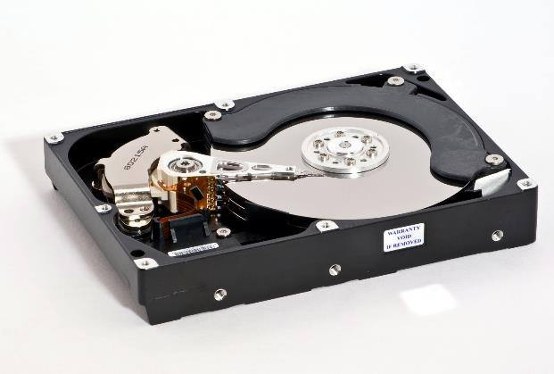
1.3.4 Storage Devices
Hard Disk Drives
Stores data, OS, and application programs
Ability to read, write, and delete (non-volatile storage)
Capacity of todays drives expressed in gigabytes* and terabytes**
* Gigabytes (GB) – approx. 1 billion bytes
** Terabytes (TB) – approx. 1 trillion bytes
Christian Jansky (https://commons.wikimedia.org/wiki/File:Samsung_HD753LJ_03-Opened.jpg), „Samsung HD753LJ 03-Opened“, https://creativecommons.org/licenses/by-sa/3.0/legalcode

Slide 17
1.3.4 Storage Devices
Removable Media
Includes (But not limited to)
USB flash drives, external hard disk drives, memory cards, and DVD/Blu-Ray drives
Advantages
Easily transported (don’t need to transport whole device)
Disadvantages
Have to be connected to device to use (not always available)

Slide 18
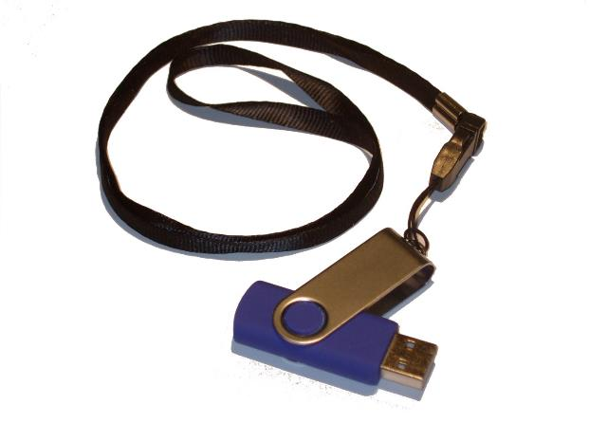
1.3.4 Storage Devices
USB Flash Drives
Often referred to as pen or thumb drives
Connect via USB port
Composed of flexible material
Non-volatile
Ability to read, write, and delete
Removable / easy to carry

Slide 19
1.3.4 Storage Devices
Memory Cards
Popular in consumer electronics like phones, tablets, and cameras
Can be used on a computer with a card reader
They are small and less obtrusive when mounted in a recessed slot

Slide 20
1.3.4 Storage Devices
External storage
Usually a networked server with associated local storage
“Cloud” is nothing more than a networked mass storage device maintained by someone else
Examples include Microsoft One Drive and Google Drive
Companies often have their own server farm for employee use

Slide 21
1.3.5 Motherboard
Connects hardware components together
Contains places for plugging in cards for controlling the monitor and printer
Contains special slot for plugging in CPU

Slide 22
1.4 Computer Software
Program (software)
Detailed set of instructions
Directs actions of the computer system
Instructions written in a programming language by ‘programmers’

Slide 23
1.4 Computer Software
Programmers (software developers)
Write, test, implement, and maintain software
First programmer – Ada Lovelace
Skills needed:
Ability to solve problems
strong communication skills
work well in a team
programming background

Slide 24
1.4.1 Application Software
Application software – targeted at end users
Word processors
Spreadsheets
Chat programs
Integrated Development Environments

Slide 25
1.4.1 Application Software
System software
Manages hardware components
Coordinates loading and execution of programs
Operating System (OS)

Slide 26
1.4.2 System Software
Operating System (OS)
Manages input requests from the keyboard and mouse
Manages output requests to the printer or the monitor
Interface between hardware and user

Slide 27
1.4.2 System Software
Graphical User Interface (GUI)
Includes pictures and symbols
Designed to make program easier to use
Examples include Windows, Linux, iOS, and Android

Slide 28
1.5 Embedded Systems
MohammadHabib93 (https://commons.wikimedia.org/wiki/File:Arduion_type.png), „Arduion type“, https://creativecommons.org/licenses/by-sa/3.0/legalcode
Designed to perform one or a limited number of tasks
Often involves putting both hardware AND software (or firmware) together on single chip

Slide 29
1.5 Embedded Systems
Firmware – software designed to be in embedded system environment
No longer volatile
Performs limited number of predefined task
Examples can be found in
Medical equipment
Household appliances
Automobiles
Cell phones
And many more

Slide 30
1.6 Programming Paradigms
Different ways of visualizing a solution or the overall projects structure
Procedural Programming Paradigm
Break problem into pieces
Examples: C and Pascal
Object-Oriented Programming (OOP)
Focus on ‘objects’ (person, dog, radio, car, textbook) and their relationships and interactions
Examples: C++, Java, and C#

Slide 31
1.6 Programming Paradigms
Functional Programming Paradigm
Roots in mathematics
Program made up mathematical functions
Example: Lisp

Slide 32
1.7 Programming Languages
Hundreds of languages have been developed
Best programming language? Based upon the particular application being developed
Older languages | Some popular languages
FORTRAN | Java
COBOL | C
BASIC | C++
Pascal | C#
Smalltalk | Ada
C | Python

Slide 33
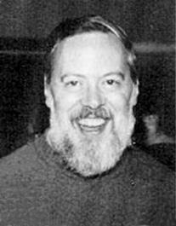
1.7.1 C Programming Language
Developed C between 1969 – 1973
Designed originally for Unix – became very portable
Easy access to hardware
Often used with embedded systems
Developed by professionals for professionals
Dennis Ritchie Bell Labs
Bojars (https://commons.wikimedia.org/wiki/File:Dennis_Ritchie.jpg), https://creativecommons.org/licenses/by-sa/4.0/legalcode

Slide 34
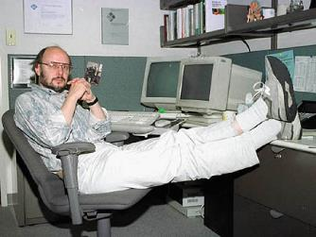
1.7.2 C++ Programming Language
Developed C++ in late 1970’s
Augments the C language
First version: C with Classes
Included constructs for object-orientated functionality
Powerful – widely used today
Bjarne Stroustrup – Bell Labs
(https://commons.wikimedia.org/wiki/File:BjarneStroustrup.jpg), "Bjarne Stroustrup"

Slide 35
1.8 Data Hierarchy
Method of grouping data or information
Bit (Binary digit) – fundamental unit of storage
Holds either 0 or 1
Byte – memory to hold 1 character
Usually made up of 8 bits
Field – collection of related bytes
Examples: First name, Student ID
Data Hierarchy
Bit
Byte
Field
Record
Database

Slide 36
1.8 Data Hierarchy
Database – Collection of separate files
Database Management System (DBMS) – tool that helps in handling the maintenance and retrieval of all data

Slide 37
1.9 Numbering Systems
Common numbering systems
Decimal – Base 10 Example: 255₁₀
Binary – Base 2 Example: 11111111₂
Hexadecimal – Base 16 Example: 0xFF₁₆
Octal – Base 8 Example: 377₈
Humans usually use decimal system
Computers like numbering systems based on powers of two

Slide 38
1.9 Numbering Systems
Numbering systems determine the range of digits used
Decimal: 0 – 9
Binary: 0 and 1
Octal: 0 – 7
Hexadecimal: 0 – 9 and A – F

Slide 39
1.9.1 Counting
Counting steps for decimal:
Start a single digit at 0
Increment digit until it reaches 9
Add another digit to left of first digit starting at 1
The first digit (least significant) is reset to 0

Slide 40
1.9.1 Counting
Counting steps for other bases use the same premise

Slide 41
1.9.1 Counting
Hexadecimal uses 16 digits so A – F is used in addition to 0 – 9

Slide 42
1.9 Numbering Systems
Same process can be used to create other bases
1993 - Telegrafix created RIPScript
Used to send drawing commands to a remote computer
Used “meganum”, a base 36 number (0 – 9 and A – Z)

Slide 43
1.9.2 Converting from a Base to Base 10
Step 1: Labeling the digits
Label the digits of the number to be converted starting at least significant digit
Least significant digit should be labeled as position 0
Following illustrates the process on a hexadecimal number

Slide 44
1.9.2 Converting from a Base to Base 10
Step 2: Calculating the value of each digit
Multiply the digit value by the current base raised to the position of the digit

Slide 45
1.9.2 Converting from a Base to Base 10
Step 3: Add the digit values – determining the result
The sum of the values from Step 2 is the base 10 number

Slide 46
1.9.3 Converting from base 10 to a different base
Step 1: Divide base 10 number by the desired base
Using the base 10 number calculated in previous section
Base 10 number: 3,130
Desired base: 16

Slide 47
1.9.3 Converting from base 10 to a different base
Step 2: Find digit value
Remainder from the previous is the digit value
Remainder = 10

Slide 48
1.9.3 Converting from base 10 to a different base
Step 3: If appropriate, convert to letter representation
If remainder is greater than or equal to 10, convert to letter representation
This becomes the least significant digit
Remainder = 10 = A

Slide 49
1.9.3 Converting from base 10 to a different base
Step 4: Repeat Steps 1 - 3
Repeat the previous three steps
Use the result as the new dividend
Continue the process until the result equals 0
Remainder: 3
Remainder: 12 (C)
Result is C3A₁₆

