Slide 1
Chapter 2 Program Design and Development

Slide 2
2.1 Procedural Programming
Program - specific set of structured (or ordered) operations to be performed by a computer
Programming paradigms - approaches used to conceptualize how to solve a specific problem or design and structure a program
One paradigm - procedural programming - performs the steps needed to solve a problem in sequential and logical manner

Slide 3
2.2 Problem Solving Overview
Crucial to clearly understand the problem
Do first
Not always easy
Not always obvious
Takes practice
Having a problem solving strategy is helpful
Think about how you solve problems (i.e., getting registered for classes, planning a party, going to school, etc.)

Slide 4
2.2.1 Development Process – Step 1
Step 1: Define the Problem
Determine what needs to be accomplished
Can be very challenging to do
Crucial to get this right

Slide 5
2.2.1 Development Process – Step 2
Step 2: Requirement Specification
Remove ambiguities from the problem definition
Determine output or results
Determine input needed, along with its source – keyboard, file, etc.

Slide 6
2.2.1 Development Process
Carefully consider need for one activity to be completed before beginning another
Before adding (processing) two numbers together need to input the numbers
Before displaying (outputting) the results, must first do the necessary processing
Many programs require each of the three stages below
Input -> Process -> Output (IPO)

Slide 7
2.2.1 Development Process – Step 3
Step 3: Design
Develop an algorithm for a small piece of the problem or program
Guarantee you have sufficient detail to:
Account for all required input
Complete necessary processing steps
Generate the output or solution identified in the Requirement Specification (Step 2)

Slide 8
2.2.1 Development Process – Definitions
Algorithm - finite set of instructions that leads to a solution
Desk checking – verifying logic of proposed solution
Use sample data to validate or desk check results by hand

Slide 9
2.2.1 Development Process – Step 4
Step 4: Implementation
Write the source code based upon algorithm (pseudocode) designed in Step 3
Avoid temptation to write code before the pseudocode

Slide 10
2.2.1 Development Process – Step 5
Step 5: Testing and Verification
Make sure the program works
Double check output for correctness
Crucial step

Slide 11
2.2.1 Development Process – Step 6/7
Step 6: Repeat Steps 3 - 5
Now that one piece is working, repeat the process on the next piece
Step 7: Maintenance
Revise and enhance the program
As crucial as any of the other steps
Keep this step in mind as code is designed and implemented

Slide 12
2.2.1 Development Process - Summary
Step 1: Define the problem
Step 2: Requirements specification
Step 3: Design
Step 4: Implementation
Step 5: Testing and verification
Step 6: Repeat Steps 3 – 5
Step 7: Maintenance

Slide 13
2.3 Algorithm Representation - Flowchart
Termination
Termination – marks the start or the end of the flowchart
Process – any activity associated with manipulating the data
Decision – direction of flow based upon either true or false condition
Input/Output (I/O) – reading data (input) or displaying results (output)
Flow of control
Process
Decision
Input /
Output

Slide 14
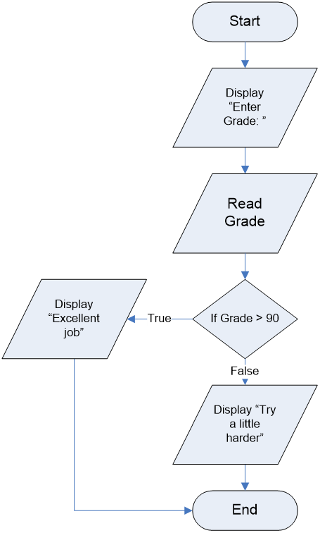
2.3 Algorithm Representation - Flowchart
Flow is top down
Diamond indicates a choice or conditional path
Used to demonstrate flow of any system

Slide 15
2.3 Algorithm Representation - Pseudocode
Textual representation of an algorithm
Doesn’t use predefined symbols
Not based upon any programming language
Example: Display Prompt "Enter Score: "
Read Score from keyboard
If Score > 90
Display "Excellent job"
Else
Display "Try a little harder"

Slide 16
2.3 Algorithm Representation - Pseudocode
Hints for developing pseudocode:
Provide a significant level of detail
Find gross_wages too vague
Better: Multiply hours * rate giving gross_wages
Explains HOW to accomplish a task and WHAT tasks to perform
Once developed, convert or translate into a specific programming language

Slide 17
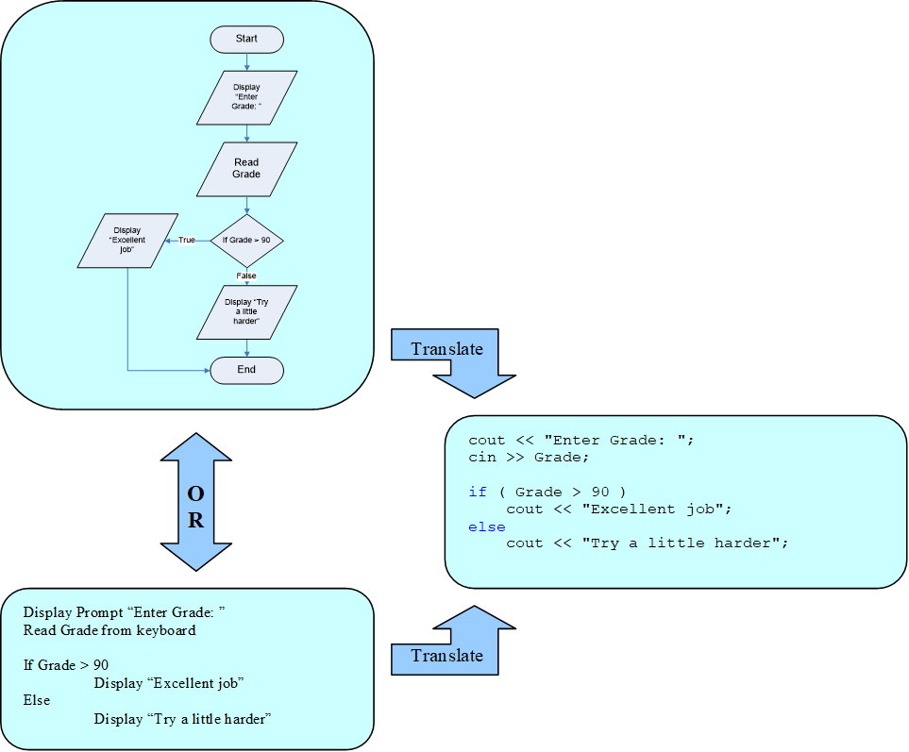
2.3.2 Translation Process
Translate algorithm to desired language (in our case C++) – Step 4 of Development Process

Slide 18
2.4 Algorithm Development
Important to identify all necessary steps and place them in the right order
Need Input before Processing
Need Processing before Output
Input -> Process -> Output (IPO)
Design algorithms BEFORE you write your code
Saves you time in long run

Slide 19
2.4.2 Stepwise Refinement
Breaking program down to smaller, more manageable and detailed pieces (Step 6 in Development Process)
Take the first piece - design, implement and test it
If correct, move on to next piece
If not correct, fix before continuing
Advantages:
Saves time
Confines errors in smaller area making them easier to find

Slide 20
2.5 Compilation Process
Compilation translates source code into a form the computer can understand
Three options:
Compilation
Interpretation
Combination of both (Hybrid)

Slide 21
2.5 Compilation Process – Compilation
Translates entire program to machine language
Completed only once (unless changes made to source code)
Must be recompiled to run on different OS’s
Runs faster than interpreted language
Examples: C and C++

Slide 22
2.5 Compilation Process – Interpretation
Each line of source code is translated and then executed immediately
Takes place while program is running (slow)
Program reinterpreted whenever run
Examples: HTML, LISP, Forth usually interpreted

Slide 23
2.5 Compilation Process – Hybrid
Includes parts of both compilation and interpretation
Program compiled into an intermediate form which is then interpreted when executed
Example: Java

Slide 24
2.5.1 Editor
Used to enter in source code to create a text file with an appropriate extension such as .cpp, .h, or .c
Integrated Development Environment (IDE)
Includes a number of development tools, including an editor
Editor often includes color coding keywords, automatic text formatting, and intellisense

Slide 25
2.5.2 Preprocessor
First step in translation process after entering source code
Identifies special commands within your code (preprocessor directives) and performs the tasks specified by the directives
Preprocessor directives begin with pound (#) sign
Examples: #include, #define

Slide 26
2.5.3 Language Translator – Compiler
Follows preprocessor stage
Translates or converts the source code into object code
Object code - mostly machine code understandable by CPU
Stored in an object file
Binary file - extension .obj

Slide 27
2.5.4 Linker
Combines object files into one executable file
File extension (under Windows) – .exe
Executable file can be run on the operating system it was compiled for

Slide 28
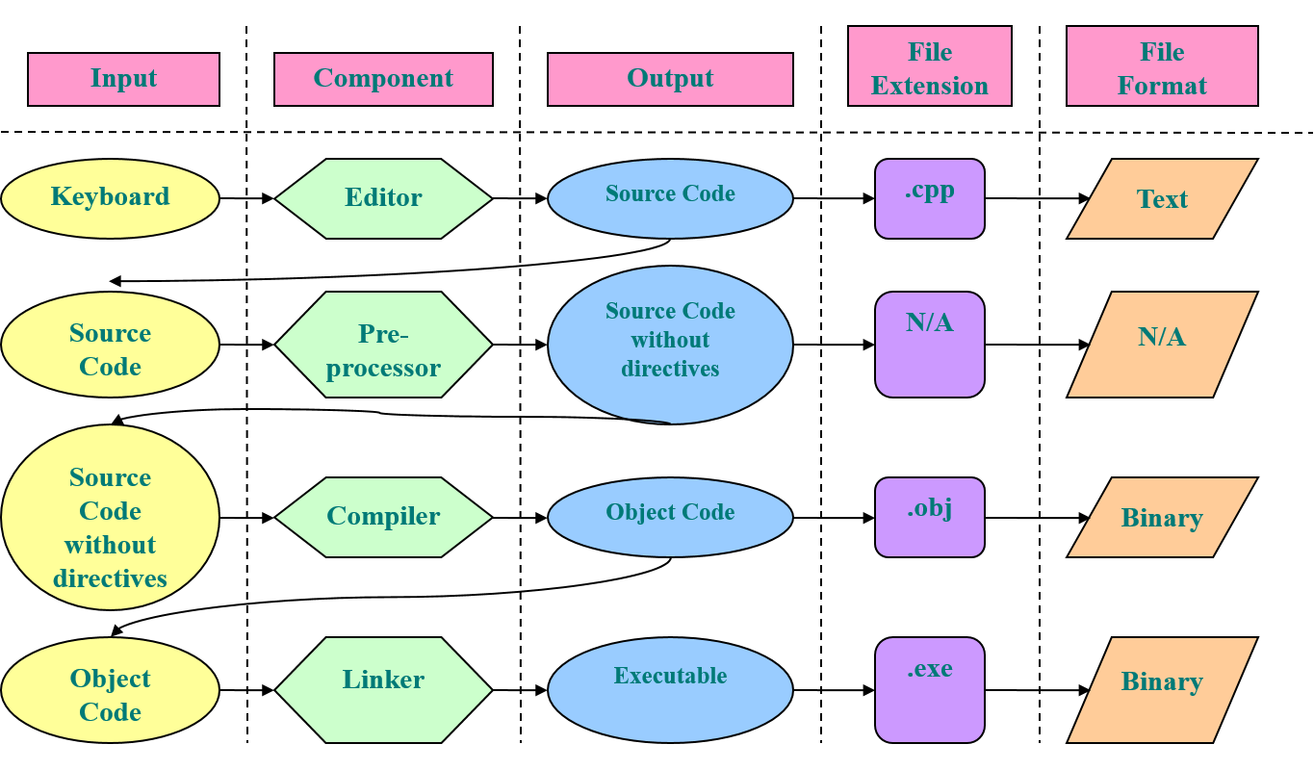
2.5.4 Compilation Process

Slide 29
2.6 Program Development in Visual Studio (VS)
Suite of tools to facilitate programming activities
Support for writing programs in C++, C, C#, and Python
Builds apps for Windows, mobile devices, and Websites
Example of an IDE
Includes editor
Language translator
Debugger
and much, much more

Slide 30
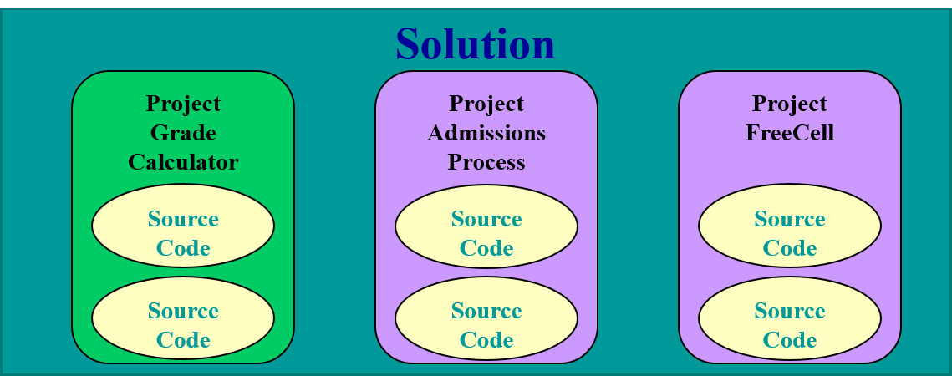
2.6.1 Using an Integrated Development Environment – VS
Components
Solution
includes one or more projects
Project
encapsulates one or more source code files
each project represents one complete program

Slide 31
2.7 Running the Program
Run .exe file from Windows
Double-click on the file from Windows Explorer
Run from the Command Prompt
Run from within IDE (easiest method)

Slide 32
2.8.1 Syntax Error - Definition
Syntax error –problem with mechanics of the statement(s)
Examples – spelling a keyword wrong, missing a semicolon, etc.
Executable can’t be created until all syntax errors are corrected
Found during the compilation process
Identified and displayed by the compiler

Slide 33
2.8.1 Syntax Error - Tips
Compiler determines severity of the syntax error
Includes minor errors - compiler flags error as a warning
Program still compiles, but may or may not run correctly
Tips:
Remove all warnings as well as errors before running your program
Correct the first error or warning in the compiler generated list and re-compile before going on to next error

Slide 34
2.8.2 Linker Error
Linker error – identified by the linker during the build process
Error messages often cryptic and hard to understand
Show up when you start writing your own functions
Can’t create an executable file until corrected

Slide 35
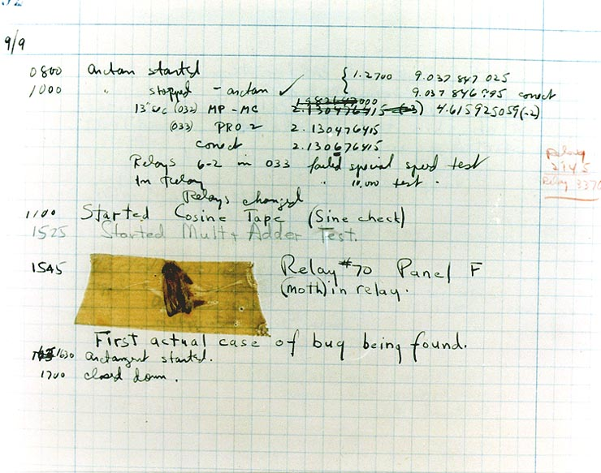
2.8.3 Run-Time Error
Run-time error – program suddenly terminates during execution
Wide range of causes - including dividing by zero
Debugger can help find or isolate the error
Debugger - set of tools programmer uses to locate errors (or bugs)
Bug - another term used for a program error
Grace Hopper

Slide 36
2.8.4 Logic Error
Logic error – program compiles, links, and runs to completion but doesn’t produce correct results
Most difficult type of error to find
Debugger helpful to locate logic errors
Stepwise refinement will help narrow down the place where the error was introduced (because each module should be thoroughly tested)

Slide 37
2.9 Desk Checking
Draw out by hand (on paper) overall flow and results of the program BEFORE running it
Aids in finding various bugs and problems in the source code BEFORE they enter into the compilation of your program
Excellent tool to use in locating errors
Always verify your results
Notes:
Demo Creating a project in the current version of Visual Studio

Slide 38
2.11 Debugging
Process of removing run-time and logic errors
Many tools available
Integrated into the IDE
Won’t find the errors for you
Debugging tools only help find logic and run-time errors
Syntax and linker errors must be corrected before using debugging tools
Extremely important to learn how to use the debugger

