Slide 1
Chapter 10 Arrays and cStrings

Slide 2
10.1 What Are Arrays? – Definition
Array
Collection of two or more contiguous memory cells of a homogenous data type
Associates multiple pieces of data with one variable name
Three key points
Never declare an array that holds only a single piece of data
Each element is physically adjacent to each other in memory
An array can only contain a single type of data

Slide 3
10.1 What Are Arrays? – Important Concept
Element
Area within a block of memory where one piece of data will be stored
Name of an array refers to its starting address
Address of an array is a constant address
Can never be on left side of an assignment operator

Slide 4
10.1.1 Advantages and Disadvantages of Arrays
Advantages
Quickly declare a number of related elements, all of the same type
Can use any data type
Useful when sorting or searching information
Provide fast and easy method for accessing a potentially large amount of data
Disadvantages
If declared to hold 100 elements, and end up needing only 10, computer resources wasted
Going outside of the memory allocated can be a difficult programming error to find

Slide 5
10.2 Declaring Arrays – Syntax
Syntax
<data-type> <array-name> [<num-elements>];
Data type and naming rules same as variables
num-elements must be an integer constant or a literal specifying total number of elements
Cannot use a variable to represent the number of elements in declaration

Slide 6
10.2 Declaring Arrays – Examples 1 and 2
// Example 1
char first_name[20];
// Example 2
const int LEN = 20;
char last_name[LEN];
Example 1
Character array first_name with 20 elements
Example 2
last_name declared with the number of elements established by LEN

Slide 7
10.2 Declaring Arrays – Examples 3 and 4
// Example 3
int test_scores[5];
// Example 4
int lab_scores[4], assignment_scores[4];
Example 3
Array of five individual integer elements
Example 4
Two arrays of integers, both contain four elements

Slide 8
10.2 Declaring Arrays – Miscellaneous Information
Going out of bounds
Accessing an element, or memory cell, that does not belong to the array
Use constants to make code more readable and easy to modify

Slide 9
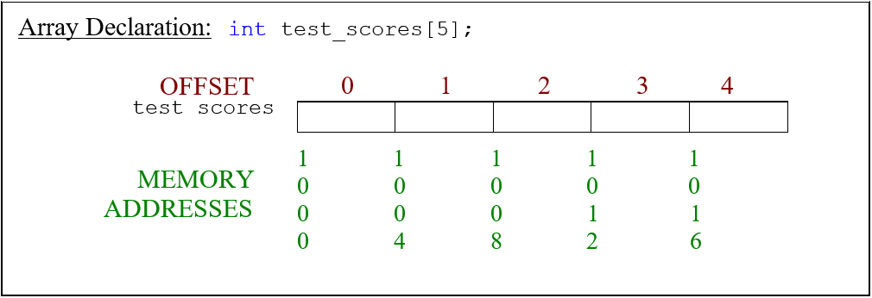
10.3 Using Arrays – Subscript Operator
Subscript operator ([ ])
Used to access a specific element in an array
Specifies offset from the beginning address
Access first element with offset of 0, second element an offset of 1, etc.

Slide 10
10.3 Using Arrays - Examples
int offset = 2;
// 5 elements referenced 0 – 4
int test_scores[5];
// 0 offset or first array element test_scores[0] = 94;
// 1 offset or second array element test_scores[1] = 89;
// 2 offset or third array element
test_scores[offset] = 65;

Slide 11
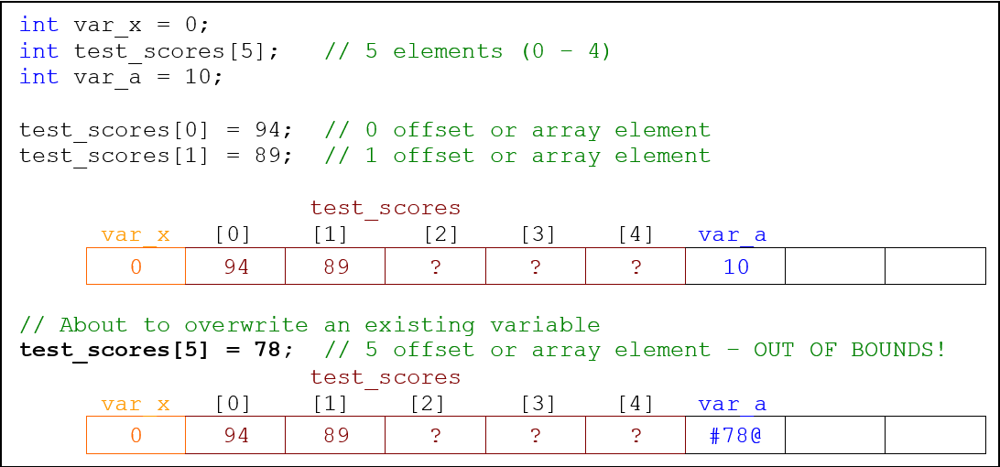
10.3 Using Arrays – Going out of Bounds

Slide 12
10.3 Using Arrays – Going out of Bounds Problems
Incorrect data can occur
Program could immediately terminate or crash with a runtime error
Program could crash upon exiting
Malicious hackers will often exploit programs with these vulnerabilities
Buffer overrun, or overflow, security holes can allow hackers to write to special areas of memory to add malicious code
We cannot stress strongly enough that it is critical to bounds check your arrays

Slide 13
10.4 Initialization – Syntax
Array initialization syntax:
<data-type> <name> [ <number-elements> ] = { val1, val2, … };
<data-type> <name> [ ] = { val1, val2, … };
<data-type> <name> [ <number-elements> ] { val1, val2, … };
<data-type> <name> [ ] { val1, val2, … };
First example
If fewer values are provided than the number of elements, remaining elements will be allocated but hold unknown values
Second example
Number of values in the braces determines the size of the array, if 10 values, there will be 10 elements allocated
Third and Fourth examples
Use the newer fully uniform type initialization

Slide 14
10.4 Initialization – Example
int nums[5] = { 0, 1, 2, 3, 4 };
float reaction_times[]{ 0.005F, 0.001F };
char grades[5] = { 'A', 'B', 'C', 'D', 'F' };
int frequency_counts[5]{ 1 };
frequency_counts
Uses a single value for initialization
First element initialized to 1
In most environments remaining elements initialized to 0

Slide 15
10.4 Initialization – Size Determination
You can determine the size of an array after it is declared as shown below
int test_scores[] = { 85, 92, 83 };// No value specified for array size
int num_elements = sizeof ( test_scores ) / sizeof ( test_scores[0] );
cout << "num_elements = " << num_elements;
// Output num_elements = 3

Slide 16
10.5 Array Manipulation – Filling Entire Array
Read and write arrays one element at a time (with one exception)
Loops become crucial in performing array operations, especially I/O
The loop below requires user to enter 25 scores
Notice the use of the constant to control the limits of the loop
const int NUMBER_STUDENTS = 25;
int test_scores[NUMBER_STUDENTS]{ 0 };
for ( int i = 0; i < NUMBER_STUDENTS; i++ )
{
cout << "Enter Test Score #" << i + 1 << ": ";
cin >> test_scores[i];
}
Notes:
Remember: A for loop is generally used when you need to repeat statements a specific number of times.

Slide 17
10.5 Array Manipulation – Filling Portion of Array
Terminates when maximum number of values is entered or when user chooses to quit
num_values will hold the number of elements used
int values[MAX_VALUES] = { 0 };
int num_values = 0;
char enter_another = 'n';
do
{
cout << "Enter a value: ";
cin >> values[num_values++];
cout << "Enter another value (y/n)? ";
cin >> enter_another;
} while( toupper ( enter_another ) == 'Y' && num_values < MAX_VALUES );
for ( int i = 0; i < num_values; i++ )
sum += values[i];

Slide 18
10.6 Passing Arrays to Functions – Passing by Pointer
Arrays are passed by pointer
Passing by pointer
Similar to passing by reference (more in Chapter 12)
Changes made to the array inside function are permanent
Why passing by pointer?
Only need pass the address (name) of the array (size of an address)
Instead of making a complete copy
Downside
Functions have the ability to change the array

Slide 19
10.6 Passing Arrays to Functions – Declarations and Calls
// Function declarations
int GetValues ( int values[] );
float CalculateMean ( int values[], int num_values );
int FindMode ( int values[], int num_values );
// Function calls passing arrays
num_values = GetValues ( values );
mean = CalculateMean ( values, num_values );
mode = FindMode ( values, num_values );
Although legal to specify number of elements in the array within brackets of the function declaration, it usually isn’t done

Slide 20
10.6 Passing Arrays to Functions – Passing One Element
What if we only wanted to pass one element of the array?
// Function declarations
void Fun1 ( int element_by_value );
void Fun2 ( int & element_by_reference );
// Function calls passing one element
Fun1 ( values[0] );
Fun2 ( values[1] );

Slide 21
10.6 Passing Arrays to Functions – Complete Example
#include <iostream>
using std::cout;
using std::cin;
using std::endl;
const int MAX_VALUES{ 25 };
int GetValues ( int values[] );
float CalculateMean ( int values[], int num_values );
int FindMode ( int values[], int num_values );
int main ( )
{
int values[MAX_VALUES]{ 0 }, num_values{ 0 }, mode{ 0 };
float mean{ 0 };
num_values = GetValues ( values );
mean = CalculateMean ( values, num_values );
mode = FindMode ( values, num_values );
cout << "Mean = " << mean << endl;
cout << "Mode = " << mode << endl;
return 0;
}

Slide 22
10.6 Passing Arrays to Functions – GetValues
int GetValues ( int values[] )
{
int num_values = 0;
char enter_more = 'n';
do
{
cout << "Enter a value: ";
cin >> values[num_values++];
cout << "Enter another value (y/n)? ";
cin >> enter_more;
} while ( toupper ( enter_more ) == 'Y' && num_values < MAX_VALUES );
return num_values;
}

Slide 23
10.6 Passing Arrays to Functions – FindMode
int FindMode ( int values[], int num_values )
{
int mode;
int count, oldcount = 0;
// Searching through the array for the most commonly used number
for ( int i = 0; i < num_values; i++ )
{
count = 1;
for ( int j = i + 1; j < num_values; j++ )
{
if ( values[i] == values[j] )
count++;
}
if ( count > oldcount )
{
mode = values[i];
oldcount = count;
}
}
return mode;
}

Slide 24
10.6 Passing Arrays to Functions – CalculateMean
float CalculateMean ( int values[], int num_values )
{
float sum = 0;
for ( int i = 0; i < num_values; i++ )
sum += values[i];
return sum / num_values;
}

Slide 25
10.6 Passing Arrays to Functions – const Array Parameters
It is possible to pass arrays to functions so they cannot be changed
// Function Call
DisplayValues ( values, num_values );
// Function Definition
void DisplayValues ( const int values[], int num_values )
{
for ( int i = 0; i < num_values; i++ )
cout << values[i] << ' ';
// Invalid because the array cannot be changed
// values[0] = 99;
}

Slide 26
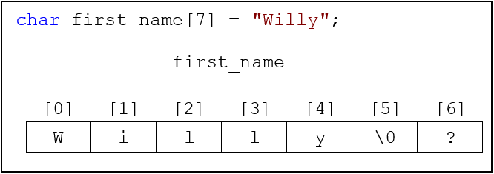
10.7 Special Case: cStrings – Null Character
cString
C-style, null terminated, character array
Null character
ASCII value 0, represented as ‘\0’
When declaring a cString, allocate one extra element to hold the null character

Slide 27
10.7.1 cString Initialization – Character by Character
It is possible to initialize a cString character by character
Not preferable method
Must supply the null character
String literal can only be used to initialize a cString
Illegal to assign a string literal to a cString
last_name = "Murray"; // ERROR!

Slide 28
10.7.2 I/O with cStrings – cout
cout takes the address given and prints to the output buffer character by character until a null character ('\0') is encountered
Critical that the null character always be present in any cString
If no null character, cout continues to print until the program is stopped, it crashes, or cout happens to find a null character

Slide 29
10.7.2 I/O with cStrings – cin
cin reads from input buffer one character at a time, storing each in the cString variable
Continues until a whitespace character is read
A null character is then inserted into the next character location, terminating the cString
Problems with cin
Because whitespace is used to delimit input, impossible to read a space from the keyboard
If too many characters entered cin reads all characters up to the first whitespace, even if it means going out of bounds of the array
Notes:
Remember: whitespace is defined as a space, tab, or newline.

Slide 30
10.7.2 I/O with cStrings – .getline Using Default Argument
getline
Allows specifying maximum number of characters to be read
Stops reading when newline character is encountered, or the maximum length, minus 1, is reached
// Room for up to 80 characters + null character
char whole_name[81];
cout << "Please enter your whole name: ";
cin.getline( whole_name, 81 ); // getline with 2 parameters
cout << "Here is the whole name: " << whole_name<< endl;
// Output
Please enter your whole name: I. M. Sample
Here is the whole name: I. M. Sample

Slide 31
10.7.2 I/O with cStrings – .getline with Delimeter
// Room for up to 80 characters + null character
char whole_name[81];
cout << "Please enter your whole name: ";
cin.getline ( whole_name, 81, '-' ); // getline with delimeter
cout << "Here is the whole name: " << whole_name << endl;
// Output
Please enter your whole name: Lori Murray-Smith
Here is the whole name: Lori Murray

Slide 32
10.7.2 I/O with cStrings – .getline Potential Problem
If a new line character is already in the input buffer, .getline reads the character and continues without the user being able to enter anything at the keyboard
Where could that new line character come from?
Most often from other cin statements
Asked for age, user entered 20 and pressed the enter key to signify they are done, all three keys pressed go into the input buffer
The 2 and the 0 are read from the input buffer and stored in the variable
Because cin is whitespace delimited, the enter key is left in the input buffer

Slide 33
10.7.2 I/O with cStrings – .getline Second Problem
Second problem occurs if user typed too many characters at the keyboard the last time a .getline function executed
Maximum number of characters specified are read and stored in the cString variable
Rest of the characters are left in the buffer
When next .getline executes, user doesn’t get to enter anything because .getline reads existing information from the input buffer

Slide 34
10.7.2 I/O with cStrings – Flushing Input Buffer
char whole_name[81];
cout << "Please enter your whole name: ";
// Flush garbage from buffer
cin.ignore ( cin.rdbuf ( )->in_avail ( ) );
cin.getline ( whole_name, 81 );
// Clear the error flags
cin.clear ( );
// Flush characters not read
cin.ignore ( cin.rdbuf ( )->in_avail ( ) );
cout << "Here is the whole name: " << whole_name << endl;
Notes:
Note: Although not intuitive, .getline sets a flag if it reads the maximum number of characters. If this happens, the .clear function call is required to reset any flags that may have been set by the .getline function.
Remember: Using cin allows us to read one word at a time. The .getline method allows us to read a sentence.

Slide 35
10.7.3 cStrings and “address of” Operator
Address of operator (&)
Returns address of its operand
char first_name[7] = "Alexis";
for ( int i = 0; i < 7; i++ )
cout << &first_name[i] << endl;
// Output
Alexis
lexis
exis
xis
is
s

Slide 36
10.8 cString Functions - Reasons
Illegal to assign a cString or string literal to another cString
Cannot compare the contents of two cStrings
Even though the two string values are the same, the relational operator compares two addresses, not the strings, which will always be false
char str1[15] = "Troy";
char str2[15] = "Troy";
if ( str1 == str2 ) // DON’T DO THIS
cout << "Your name is Troy.";
else
cout << "Your name is Mud.";
// Output
Your name is Mud.

Slide 37
10.8 cString Functions – Header File
Predefined functions accessible through <cstring>
No namespaces exist in the header file
All functions expect at least one cString parameter

Slide 38
10.8.1 cString Function Standards – Non Standard Functions
Many of the functions we will discuss in this section are not ANSI standard functions
strlwr, strupr, and stricmp functions provided by Microsoft with Visual Studio compiler
If you are developing with a different IDE, you may or may not have these functions available to you

Slide 39
10.8.1 cString Function Standards – Bounds Checked Functions
Microsoft Visual Studio flags many cString functions as deprecated
Deprecated function
Has a newer function to take its place
Microsoft would rather you use the strcpy_s function that is considered “safer” than the strcpy function
The newer function has a different syntax that provides a more secure functionality
This has been done to alleviate the problems with buffer overrun errors and attacks
The current ISO standard, C++ 17, lists the _s functions, also known as bounds-checked functions, as an optional implementation for compilers

Slide 40
10.8.1 cString Function Standards – Visual Studio
Visual Studio will produce a warning or error if deprecated functions are used
To use the older functions without receiving a warning or error, include the following line at the beginning of your source code
#define _CRT_SECURE_NO_WARNINGS
Some functions such as strrev and stricmp may have newer standards
Can be accessed by placing an underscore at the beginning of the function
For example, strrev would become _strrev
Notes:
Note: The status of these functions is in a state of flux. Don’t be discouraged or disappointed about this. The functions discussed in this chapter are still widely used.

Slide 41
10.8.2 Copying – Syntax
Illegal to assign a cString or string literal to another cString
All copy up to, and including, null character from source to destination
Destination
Must be a cString variable
Source
Either a cString or a string literal
strcpy ( <destination>, <source> );
strncpy ( <destination>, <source>, <number-chars> );
// C++ 11 optional functions. Not supported by all environments.
strcpy_s ( <destination>, <destination size>, <source> );
strncpy_s ( <destination>, <destination size>, <source>, <number-chars> );
Notes:
Warning: If there is insufficient room in the destination, strncpy will not copy a null character.

Slide 42
10.8.2 Copying – Examples
char holder_1[10] = { 0 }; // initializing all elements to 0 (null)
char holder_2[10] = { 0 }; // initializing all elements to 0 (null)
char part_1[10] = "Hello ";
char part_2[10] = "World";
// Example 1 - strcpy
strcpy ( holder_1, part_1 );
cout << "holder_1 is: " << holder_1 << " and part_1 is: " << part_1 << endl;
// Example 2 - strncpy
strncpy ( holder_2, part_2, 3 );
cout << "holder_2 is: " << holder_2 << " and part_2 is: " << part_2 << endl;
// Output
holder_1 is: Hello and part_1 is: Hello
holder_2 is: Wor and part_2 is: World

Slide 43
10.8.3 Appending – Syntax
Functions to concatenate, or append, source onto the end of the destination
Second function appends the number of characters specified from beginning of the source on to the end of the destination
Destination must have room to hold characters from both cString parameters and required terminating
strcat ( <destination>, <source> );
strncat ( <destination>, <source>, <number-chars> );
// C++ 11 optional functions. Not supported by all environments.
strcat_s ( <destination>, <destination size>, <source> );
strncat_s ( <destination>, <destination size>, <source>,
<number-chars> );

Slide 44
10.8.3 Appending – Example
char last_name[16]; // Room for 15 characters + null character
char first_name[16];
char whole_name[32]; // make sure you have enough ro
cout << "Please enter the first name: ";
cin >> first_name;
cout << "Please enter the last name: ";
cin >> last_name;
strcpy ( whole_name, first_name );
strcat ( whole_name, " " ); // adding a space after the first name
strcat ( whole_name, last_name );
cout << "The whole name is: " << whole_name << endl;
// Output
Please enter the first name: Willy
Please enter the last name: Makit
The whole name is: Willy Makit
Notes:
Remember: Make sure the destination cString has the necessary room to hold all the characters from both cString parameters and the required terminating null.

Slide 45
10.8.4 Comparing – Syntax
These functions compare the contents of two cStrings or string literals
The “i” in stricmp/strnicmp means ignore the case
<int-var> = strcmp ( <str1>, <str2> );
<int-var> = strncmp ( <str1>, <str2>, <number-characters> );
<int-var> = _stricmp ( <str1>, <str2> );
<int-var> = _strnicmp ( <str1>, <str2>, <number-characters> );

Slide 46
10.8.4 Comparing – Return Values
All of the compare functions return one of three different values
Each function compares character by character until a difference between two characters is encountered (Lexical Analysis), then the ASCII values of the two characters are compared
Return Value | Relationship of str1 to str2
< 0 | str1 less than str2
0 | str1 equals str2
> 0 | str1 greater than str2
Notes:
Definition: Character by character comparison is often called Lexical Analysis.

Slide 47
10.8.4 Comparing – strcmp Example
int result;
char string_1[] = "Jamie";
char string_2[] = "Jaime";
cout << "\nComparing: \t" << string_1 << "\nwith: \t\t" << string_2 << "\n\n";
result = strcmp ( string_1, string_2 );
if ( result > 0 )
cout << "string_1 is greater than string_2 above\n";
else if ( result < 0 )
cout << "string_2 is greater than string_1 above\n";
else
cout << "string_1 is identical to string_2 above\n";
// Output
Comparing: Jamie
with: Jaime
string_1 is greater than string_2 above

Slide 48
10.8.4 Comparing – strncmp Example
int result;
char string_1[] = "Jamie";
cout << "\nComparing: \t" << string_1 << "\nwith: \t\tJames\n\n";
result = strncmp ( string_1, "James", 3 );
if ( result > 0 )
cout << "string_1 is greater than James above\n";
else if ( result < 0 )
cout << "James is greater than string_1 above\n";
else
cout << "string_1 is identical to string literal James\n";
// Output
Comparing: Jamie
with: James
string_1 is identical to string literal James

Slide 49
10.8.4 Comparing – stricmp Example
int result;
char upper_string[] = "MARIE";
char lower_string[] = "marie";
cout << "\nComparing: \t" << upper_string << "\nwith: \t\t"
<< lower_string << "\n\n";
result = _stricmp ( upper_string, lower_string );
if ( result > 0 )
cout << "upper_string is greater than lower_string above\n";
else if ( result < 0 )
cout << "lower_string is greater than upper_string above\n";
else
cout << "upper_string is identical to lower_string above\n";
// Output
Comparing: MARIE
with: marie
upper_string is identical to lower_string above

Slide 50
10.8.5 Finding the Length - Syntax
strlen
Returns the number of characters preceding the null character
size_t
Equates to an unsigned int (can’t have a negative)
<size_t-variable> = strlen ( <cString> );

Slide 51
10.8.5 Finding the Length – Examples
// Example 1
size_t len;
char string_1[] = "Hello World";
len = strlen ( string_1 );
cout << "The string \"" << string_1 << "\" is " << len
<< " characters\n";
// Example 2
cout << "The length of the string literal Rock and Roll is "
<< strlen ( "Rock and Roll" ) << " characters\n";
//Output
The string "Hello World" is 11 characters
The length of the string literal Rock and Roll is 13 characters

Slide 52
10.8.6 Changing the Case – Syntax
These functions change the case of an entire cString
Permanently change the parameter
Not a part of any standard
Available in Visual Studio
_strupr ( <cString> );
_strlwr ( <cString> );

Slide 53
10.8.6 Changing the Case – Example
char first_name[] = "maRie";
char last_name[] = "MUrrAY";
cout << "Original value in first_name: " << first_name << endl;
_strupr ( first_name );
cout << "Converted value in first_name: " << first_name << endl;
cout << "\nOriginal value in last_name: " << last_name << endl;
_strlwr ( last_name );
cout << "Converted value in last_name: " << last_name << endl;
//Output
Original value in first_name: maRie
Converted value in first_name: MARIE
Original value in last_name: MUrrAY
Converted value in last_name: murray

Slide 54
10.8.7 Reversing – Syntax
_strrev
Non-standard function that reverses the cString
_strrev permanently changes the actual parameter
Must be a cString and not a string literal
_strrev ( <cString> );

Slide 55
10.8.7 Reversing – Example
bool Palindrome ( const char str1[] )
{
char temp[25];
bool palindrome = false;
strcpy( temp, str1 );
_strrev( temp );
if ( _stricmp( str1, temp ) == 0 )
palindrome = true;
return palindrome;
}

Slide 56
10.8.8 Converting cStrings to Numbers – Syntax
These functions convert the parameter until they reach a character that is not valid for the return type
<double-var> = atof ( <cString> );
<long-var> = atol ( <cString> );
<long-long-var> = atoll ( <cString> );
<int-var> = atoi ( <cString> );

Slide 57
10.8.8 Converting cStrings to Numbers – Example
char string_1[] = "12345";
char string_2[] = "1234.567";
char string_3[] = "123,456";
double double_value;
double_value = atof ( string_1 );
cout << "Original cString value: " << string_1 << " after conversion: "
<< double_value << endl;
double_value = atof ( string_2 );
cout << "Original cString value: " << string_2 << " after conversion: "
<< fixed << setprecision ( 3 ) << double_value << endl;
double_value = atof ( string_3 );
cout << "Original cString value: " << string_3 << " after conversion: "
<< double_value << endl;
//Output
Original cString value: 12345 after conversion: 12345
Original cString value: 1234.567 after conversion: 1234.567
Original cString value: 123,456 after conversion: 123
Notes:
Note: Notice the impact of the comma used within string_3.

Slide 58
10.8.9 Converting Numbers to cStrings – Syntax
<radix> indicates to which base the number should be converted
The value 16 for the radix converts the number to a hexadecimal
The radix can be any value from 2 – 36
Hexadecimal values use the characters 0 – 9 and A – F to implement a base 16 number.
Base 36 extends this concept to include 0 – 9 and A – Z to represent numbers
ltoa ( <long-var>, <cString>, <radix> );
itoa ( <int-var>, <cString>, <radix> );

Slide 59
10.8.9 Converting Numbers to cStrings – Example
char converted_value[25];
int var_i;
cout << "Please enter an integer: ";
cin >> var_i;
itoa ( var_i, converted_value, 10 );
cout << "Decimal value: " << converted_value << endl;
itoa ( var_i, converted_value, 16 );
cout << "Hexadecimal value: " << converted_value << endl;
itoa ( var_i, converted_value, 2 );
cout << "Binary value: " << converted_value << endl;
//Output
Please enter an integer: 1205
Decimal value: 1205
Hexadecimal value: 4b5
Binary value: 10010110101

Slide 60
10.8.10 Summary of cString Functions
Function | Purpose
strcpy( <dest>, <source> ); | Copy source into dest
strncpy( <dest>, <source>, <n> ); | Copy n characters from source into dest
strcat( <dest>, <source> ); | Append source to dest
strncat( <dest>, <source>, <n> ); | Append n characters from source to dest
<int> = strcmp( <str1>, <str2> ); | Compare str1 to str2
<int> = strncmp( <str1>, <str2>, <n> ); | Compare first n characters from str1 to str2
<int> = _stricmp( <str1>, <str2> ); | Compare str1 to str2 with case insensitivity
<int> = _strnicmp(<str1>, <str2>, <n>); | Compare first n characters from str1 to str2 with case insensitivity
<size_t> = strlen( <cString> ); | Returns length of cString
_strupr( <cString> ); | Converts all characters to upper case
_strlwr( <cString> ); | Converts all characters to lower case
_strrev( <cString> ); | Reverses the characters
<double> = atof( <cString> ); | Converts characters to a double
<long > = atol( <cString> ); | Converts characters to a long
<int > = atoi( <cString> ); | Converts characters to an integer
ltoa( <long_var >, <cString>, <radix> ); | Converts long integer to cString using radix (base of long_var)
itoa( <int_var >, <cString >, <radix> ); | Converts integer to cString using radix (base of int_var)

Slide 61
10.9 Multi-Dimensional Arrays – Description
Both C and C++ allow multiple dimensions
After three or four dimensions arrays become difficult to visualize
Visualize two-dimensional arrays as a simple grid made up of rows and columns

Slide 62
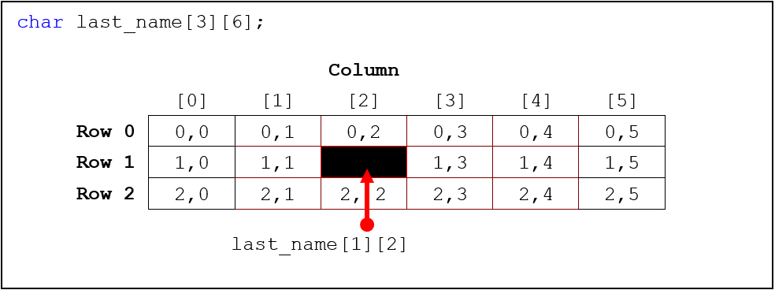
10.9 Multi-Dimensional Arrays – Visualization
Made up of 3 rows and 6 columns (total of 18 elements)

Slide 63
10.9 Multi-Dimensional Arrays – Row and Column
Referencing elements in a two-dimensional array use first subscript to represent row and second subscript for the column
last_name[row][column]
Three-dimensional arrays can be visualized as a cube
How are arrays stored?
As a contiguous block of memory

Slide 64
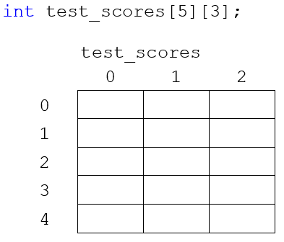
10.9 Multi-Dimensional Arrays – Storage
Visualization
Storage

Slide 65
10.9 Multi-Dimensional Arrays – Row Major Order
Row-major order
First row is stored in memory and then the next and so on
Memory associated with entire array is contiguous, similar to the memory for a one-dimensional array
Formula for finding a specific element
[desired_row * total_columns + desired_column]
Finding test_scores[2][1]
Similar to test_scores[2 * 3 + 1] or test_scores[7]
Although an important concept, always use two sets of brackets when accessing a specific element in a two-dimensional array

Slide 66
10.10.1 Declaration – Syntax
Declaring a two-dimensional array
Specify the number of rows using an additional set of brackets
Syntax for declaring a two-dimensional array
<data-type> <array-name>[ <num-rows> ][ <num-columns> ];
Syntax for declaring a three-dimensional array
<data-type> <array-name>[ <depth> ][ <rows> ][ <columns> ];

Slide 67
10.10.1 Declaration – Examples
// Example 1
char last_name[20][16];
int test_scores[20][3];
int parents_age[20][2];
// Example 2
char salesmen_id[20][5];
int monthly_sales_per_region[2][20][12];
Example 1
Declares three two-dimensional arrays for a group of 20 different students
Example 2
Holds 12 monthly sales for two different regions for 20 different salesmen
Notes:
Remember: When determining the amount of room you need to hold an array of cStrings, you must add room for the null or terminating character in each respective row. Numeric arrays do not have this requirement

Slide 68
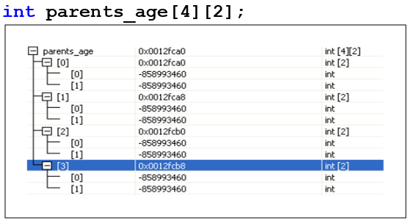
10.9.2 Initialization – Examples
int parents_age[20][2] = { 0 }; // initializes all elements to 0
char game_board[2][2] = { {'x', 'o'},
{'o', 'x'} };
char f_name[5][16] = { "Jamie", "Jody", "Linda", "Robert", "Troy" };
int test_scores[5][3]{ 90, 88, 91, 80, 80, 85, 91, 90, 94, 76, 61, 84,
19, 25, 8 };
The figure to the left is a watch window showing the uninitialized version of parents_age

Slide 69
10.9.3 Multi-Dimensional Array I/O – Number Arrays
// Example 1 - Entering data into a 2-dimensional array
int parents_age[4][2];
for ( int r = 0; r < 4; r++ )
{
cout << "Enter the 2 parents ages (i.e., 45 48): ";
for ( int c = 0; c < 2; c++ )
cin >> parents_age[r][c];
}
// Another way to accomplish the above task
for ( int r = 0; r < 4; r++ )
{
cout << "Enter the 2 parents ages (i.e., 45 48): ";
cin >> parents_age[r][0] >> parents_age[r][1];
}
// Example 2 - initializing the array
int test_scores[5][3]{ 90, 88, 91,80, 80, 85, 91, 90, 94, 76, 61, 84, 79, 85, 88 };
// Printing the data
for ( int r = 0; r < 5; r++ )
{
cout << "Student: " << r + 1 << endl;
for ( int c = 0; c < 3; c++ )
cout << " Score " << c + 1 << " equals " << test_scores[r][c];
cout << endl;
}
Notes:
Remember: For loops are used when a you know how many iterations are needed.

Slide 70
10.9.3 Multi-Dimensional Array I/O – cString Arrays
char first_name[4][16]; // To hold data for 4 students
// Reading the name into our array
for ( int r = 0; r < 4; r++ )
{
cout << "Enter the student's first name: ";
cin >> first_name[r];
}
// Another method
for ( int r = 0; r < 4; r++ )
{
cout << "Enter the student's first name: ";
cin.ignore ( cin.rdbuf ( )->in_avail ( ) ); // Flush input buffer
cin.getline ( first_name[r], 16 );
cin.clear ( );
cin.ignore ( cin.rdbuf ( )->in_avail ( ) ); // Flush input buffer
}
// Printing the names from our array
for ( int r = 0; r < 4; r++ )
{
cout << "First name is: " << first_name[r] << endl;
}
Notes:
Remember: When reading or printing arrays of cStrings, you are accessing one row of the two dimensional array. All other two-dimensional arrays must use two sets of brackets to access a specific element.

Slide 71
10.9.4 Passing Multi-Dimensional Arrays – Brackets
Only one set of brackets can be left empty
Two-dimensional arrays
Rows can be left empty but specify the number of columns
When passing, only first set of brackets can be empty, all other sets must contain values

Slide 72
10.9.4 Passing Multi-Dimensional Arrays – Examples
// Function declarations
void PlayGame ( char game_board[][2] );
void GetData ( char last_name[][16], int age[], int sales[][12] );
void PrintStudent ( char last_name[], float avg, char grade );
// Function calls
PlayGame ( game_board );
GetData ( last_name, age, sales );
// Pass one student
PrintStudent ( last_name[r], avg[r], grade[r] );

Slide 73
10.10 Parallel Arrays – Description
A number of separate, but still related arrays for holding data
First element of each of the arrays would be the data for a specific student
Second element of each array would contain all the information for a different student

Slide 74
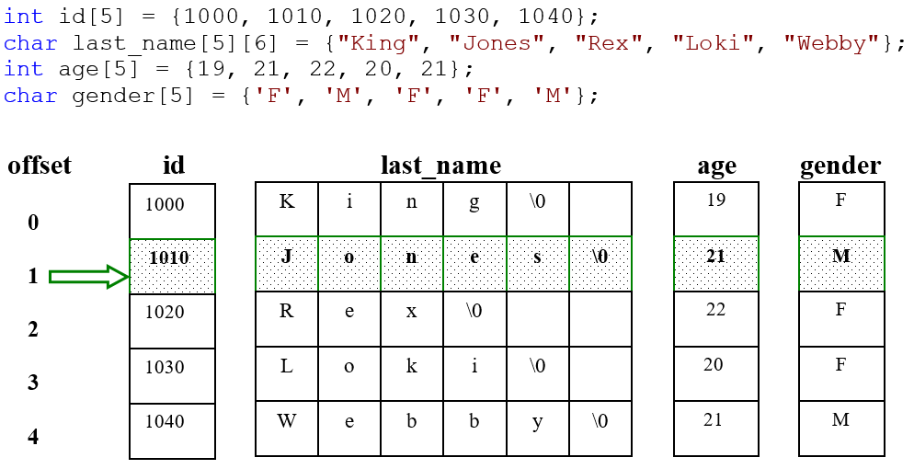
10.10 Parallel Arrays – Example
Notes:
Remember: All information belonging to a specific entity is called a record.

Slide 75
10.13 C The Differences – Strings
In C, cStrings are called strings
Need to include <string.h>
scanf
Requires any variable to be passed by pointer
Requires variable address to store information
Since the name of the array is an address, the address of operator is not needed when reading strings
Format specifier for a string is %s

Slide 76
10.13 C The Differences – Strings and scanf
/* Example 1 */
char fname [15];
printf ("What's your name? " );
scanf ( "%s", fname );
/* Example 2 */
char lnames [5][15];
int i = 0;
for ( i = 0; i < 5; i++)
{
printf ("Enter name %d: ", i + 1);
scanf ( "%s", lnames[i] );
}
printf ( "Names entered:\n" );
for ( i = 0; i < 5; i++)
{
printf ("%c%s\n", toupper(lnames[i][0]), strlwr(&lnames[i][1]));
}

Slide 77
10.13 C The Differences – scanf versus gets
With scanf, just as with cin, you can’t have strings with spaces as input
cin.getline has a counterpart called gets
gets does not specify the number of characters to be read

Slide 78
10.13 C The Differences – Strings and gets
char lnames[5][15];
int i = 0;
for ( i = 0; i < 5; i++ )
{
printf ( "Enter name %d: ", i + 1 );
flushall ( );
gets ( lnames[i] );
}

