Slide 1
Chapter 12 Pointers and Dynamic Memory Allocation

Slide 2
12.1 Definition
Pointer
Variable that holds an address
Although name of an array references the array’s beginning address, array names are not pointers
Address referenced by the name of an array is a constant address and therefore cannot be changed

Slide 3
12.1 Definition – Size of an Pointer
Pointer
Four bytes of memory (assuming a 32-bit operating system or project)
Addresses are always the same size regardless of what they point to
Advantages of pointers
Increases the efficiency of programs
Arrays become more flexible
Possibility of creating dynamic data structures

Slide 4
12.2 Declaration - Syntax
Like any other identifier, pointer variables must be declared
Syntax
<target-type> * <variable-name>;
target-type
Any data type
Asterisk
Indicates the variable will hold an address of the specified target type

Slide 5
12.2 Declaration - Example
char * ptr;
int * int_ptr;
double * dbl_ptr = nullptr;
Third example initializes the pointer to nullptr
Commonly referred to as null
Gives the pointer a known starting value, otherwise the address in the pointer is unknown

Slide 6
12.2 Declaration – Different Forms of Null
With cStrings there is also an ASCII value 0, referred to as the null character ('\0')
Use null character to terminate cStrings
Use nullptr to initialize pointers
Example from C but don’t use in C++
char * ptr = NULL;
The above line is a hold over from C and should never be used in C++ (it is incorrect C++)

Slide 7
12.2 Declaration – Multiple Declarations in One Statement
Incorrect
char * str1 = nullptr, str2;
The above statement declares one pointer, str1, and one character variable
Correct
char * str1 = nullptr, * str2;

Slide 8
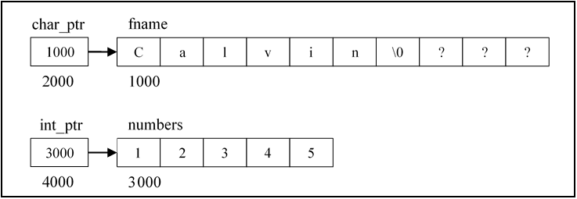
12.2 Declaration – Pointers to Arrays
char fname [10] = "Calvin";
char * char_ptr = fname;
int numbers [5] = {1, 2, 3, 4, 5};
int * int_ptr = numbers;
Notes:
Remember: The name of an array refers to its beginning address.
Remember: The target type of the pointer must match the data type of the value stored at that address.

Slide 9
12.2 Declaration – Pointers and the Address of Operator
char ch = 'A';
char * ch_ptr = &ch;
float average = 0.0F;
float * flt_ptr = &average;
int numbers [5] = {1, 2, 3, 4, 5};
int * int_ptr = &numbers[0];
Third pointer declaration demonstrates another way to retrieve the beginning address of an array

Slide 10
12.2 Declaration – Style
Spacing between asterisk and the data type and pointer name often debated
Some believe the asterisk should be next to the pointer name
int *ptr;
Others feel strongly the asterisk should be next to the data type
int* ptr;
Our preferred style
Put a space on both sides of the asterisk to insure it stands out from the data type and the pointer name
Choose a style and stick with it; be consistent
Check with the style guide for your company or school and follow it

Slide 11
12.3 Advanced Pointer Declarations – Two Star Pointer
Since can have a pointer to any data type, you can have a pointer that contains the address of yet another pointer
Typically called a two star pointer
flt_ptr_ptr will hold the address of an address that contains a float
float average = 0.0F;
float * flt_ptr = &average;
float ** flt_ptr_ptr = &flt_ptr;

Slide 12
12.3 Advanced Pointer Declarations – Levels of Indirection
Can have as many stars, or levels of indirection, as needed
Three or four levels of indirection the most you will ever see, or use
Indirection
Method of referencing a variable in a roundabout way, rather than directly accessing the variable by its name

Slide 13
12.3 Advanced Pointer Declarations – Two Dimensional Array
Can’t assign the address of a two-dimensional array to a pointer
int nums[3][5] = {{0, 1, 2, 3, 4},
{0, 1, 2, 3, 4},
{0, 1, 2, 3, 4}};
// Example 1 - Invalid
int * ptr = nums;
// Example 2 - Invalid
int ** ptr = nums;
// Example 3 - Valid
int * ptr = nums[1];

Slide 14
12.4 Indirection Operator – Description
If a pointer is used on the left side of an assignment operator, the address stored in the pointer is changed
To retrieve or alter the value that the pointer is pointing to, use the indirection operator (*)
Indirection operator removes one level of indirection
Using the indirection operator is called dereferencing

Slide 15
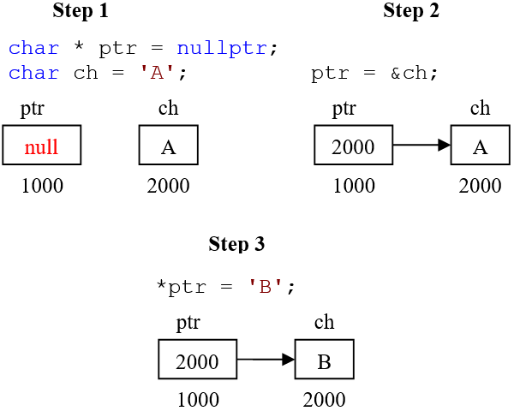
12.4 Indirection Operator – Diagram
First step declares a pointer and a character variable
Second step uses the address of operator to assign the address of ch to the pointer
Third step shows dereferencing the pointer
Once dereferenced, the value 'A' is replaced with the character 'B'

Slide 16
12.4 Indirection Operator – Single Star Example
float average = 0.0F;
float * flt_ptr = &average;
cout << "---Before---";
cout << "\n&average: " << &average
<< "\naverage: " << average
<< "\nflt_ptr: " << flt_ptr
<< "\n*flt_ptr: " << *flt_ptr
<< endl;
*flt_ptr = 5.0F;
cout << "\n---After---";
cout << "\n&average: " << &average
<< "\naverage: " << average
<< "\nflt_ptr: " << flt_ptr
<< "\n*flt_ptr: " << *flt_ptr
<< endl;
// Output
---Before---
&average: 0012FF64
average: 0
flt_ptr: 0012FF64
*flt_ptr: 0
---After---
&average: 0012FF64
average: 5
flt_ptr: 0012FF64
*flt_ptr: 5

Slide 17
12.4 Indirection Operator – Two Star Example
If two levels of indirection, dereferencing once gets to the first address and dereferencing a second time allows access to the value
float average = 20.0F;
float * flt_ptr = &average;
float ** flt_ptr_ptr = &flt_ptr;
cout << "average: " << average << "\n\n";
cout << "flt_ptr: " << flt_ptr << "\n"
<< "*flt_ptr: " << *flt_ptr << "\n\n";
cout << "flt_ptr_ptr: " << flt_ptr_ptr << "\n"
<< "*flt_ptr_ptr: " << *flt_ptr_ptr << "\n"
<< "**flt_ptr_ptr: " << **flt_ptr_ptr
<< endl;
// Output
average: 20
flt_ptr: 0012FF60
*flt_ptr: 20
flt_ptr_ptr: 0012FF54
*flt_ptr_ptr: 0012FF60
**flt_ptr_ptr: 20

Slide 18
12.5 Passing by Pointer – Description
Arrays are passed by pointer
The address of the array is passed
Can pass by pointer variables other than arrays
Especially important for those learning C
Passing by pointer is the only way C can pass variables so they can be permanently changed
Any time we have the address of a memory location we can change what is stored at that address
This is the reason passing by pointer allows changing a value within a function

Slide 19
12.5 Passing by Pointer – Example
int main ( )
{
int numer = 0, denom = 0;
GetFraction ( &numer, &denom ); // Pass by pointer
cout << numer << '/' << denom << endl;
return 0;
}
// Catch the passed address in a pointer
void GetFraction ( int * numer, int * denom )
{
cout << "Enter numerator: ";
cin >> *numer;
cout << "Enter denominator: ";
cin >> *denom;
}
// Output
Enter numerator: 1
Enter denominator: 2
1/2

Slide 20
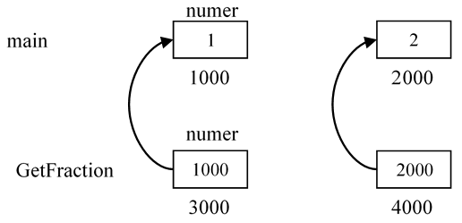
12.5 Passing by Pointer – Diagram

Slide 21
12.5 Passing by Pointer – Calling Additional Functions
What if we need to pass those pointers to another function from within GetFraction?
Do not need to pass the address of the pointers
Since we already have the addresses of the variables declared in main, you are still able to affect these original variables

Slide 22
12.5 Passing by Pointer – Calling Additional Functions Example
int main ( )
{
int numer = 0, denom = 0;
GetFraction ( &numer, &denom );
DisplayFraction ( numer, denom );
return 0;
}
void GetFraction ( int * numer, int * denom )
{
cout << "Enter numerator: ";
cin >> *numer;
cout << "Enter denominator: ";
cin >> *denom;
// Passing by pointer
FormatNegative ( numer, denom );
// Passing by value
DisplayFraction ( *numer, *denom );
}
void FormatNegative ( int * numer, int * denom )
{
if ( *numer < 0 && *denom < 0 )
{
*numer = abs ( *numer );
*denom = abs ( *denom );
}
else if ( *denom < 0 )
{
*denom = abs ( *denom );
*numer *= -1;
}
}
void DisplayFraction ( int numer, int denom )
{
cout << numer << '/' << denom << endl;
}

Slide 23
12.5 Passing by Pointer – Example Explanation
Call to FormatNegative in previous example only passes the pointer, not the address of the pointer
Call to DisplayFraction from within GetFraction dereferences both pointers before passing them, therefore passing the values
DisplayFraction catches a copy the two integers

Slide 24
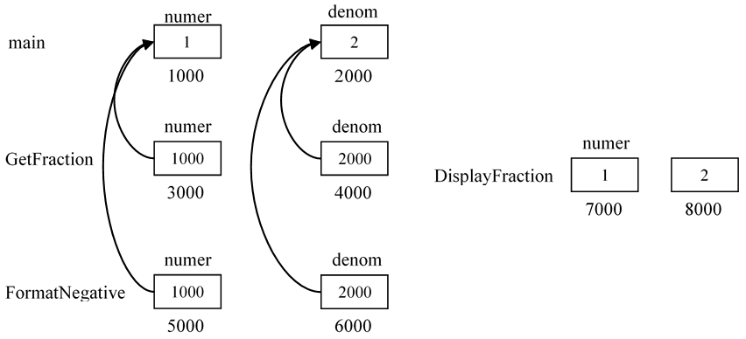
12.5 Passing by Pointer – Example Diagram

Slide 25
12.6 Pointer Arithmetic – Description
An address is a number
Size of an address depends on the OS and project settings
In a 32-bit operating system or using a 32-bit project, the address is 32 bits
Since addresses are numbers, we can perform arithmetic operations on them

Slide 26
12.6 Pointer Arithmetic – Increment Operator
char fname[15] = "Calvin";
char * ptr = fname;
for ( int i = 0; i < 3; i++, ptr++ ) // Notice the pointer math
cout << *ptr;
// Output
Cal
Increment operator moves the pointer to next element

Slide 27
12.6 Pointer Arithmetic – Increment Operator and Integers
int nums[10] = { 0, 1, 2, 3, 4, 5, 6, 7, 8, 9 };
int * ptr = nums;
for ( int i = 0; i < 3; i++, ptr++ )
cout << *ptr << endl;
// Output
0 1 2
We can’t use any mathematical operators we want
Only addition and subtraction operators can be used on pointers in the current version of the standard
Wasn’t always the case
Important to manage your pointers carefully to ensure that they maintain an appropriate address
Notes:
Note: Pointer arithmetic takes into account the size of the target type and increments appropriately, so in this example the address gets incremented by the size of an integer. Pointer increment will always take you to the next element.

Slide 28
12.6 Pointer Arithmetic – Multiple Operators Example
int * ptr = nums;
// Example 1
for ( int i = 0; i < 3; i++ )
cout << *ptr++ << ' '; // Dereference, print, increment ptr
cout << endl;
// Example 2
for ( int i = 0; i < 3; i++ )
cout << --*ptr++ << ' '; // Dereference, decrement value,
// print, increment ptr
// Output
0 1 2
2 3 4

Slide 29
12.6 Pointer Arithmetic – Example Explanation
Using excessive pointer arithmetic causes code to become more difficult to read and understand
In Example 1 on the previous slide, the indirection operator dereferences the pointer to access first element which is then printed
Address in ptr is then incremented
In Example 2, we dereference the pointer which is currently still pointing at the fourth element, value 3
The value is then decremented from 3 to 2, and then displayed
Finally, the pointer is incremented to point to the next element

Slide 30
12.6 Pointer Arithmetic – Additional Pointer Manipulation
char lname [15] = "Metzler";
char * ptr = lname;
// Example 1
cout << ptr << endl;
// Example 2 after Example 1 was run
cout << *(ptr + 2) << endl;
// Example 3 after Examples 1 and 2 were run
cout << (ptr += 3) << endl;
cout << ptr << endl;
// Output
Metzler
t
zler
zler

Slide 31
12.6 Pointer Arithmetic – Additional Pointer Explanation
In first example ptr holds the address of a character
cout will print from that address until it reaches a null character
Second example adds 2 to the beginning address pointing to the character 't'
This address is dereferenced so cout prints that specific character
Example three changes the pointer to point to the address of fourth character
cout prints starting from that address until the null character
Notice address in ptr physically changed so when we print again, get the same output

Slide 32
12.6 Pointer Arithmetic – Pointers and the Subscript Operator
Subscript operator ([]) can be used with pointers
Both subscript operator and indirection operator dereference an address
Subscript operator and the indirection operator can be used interchangeably
Although pointer notation is rarely used with arrays, array notation is often used with pointers

Slide 33
12.6 Pointer Arithmetic – Pointers and the Subscript Operator Example
All four of the following statements are equivalent
char lname [15] = "Metzler";
char * ptr = lname;
cout << lname[2] << endl; // Array notation
cout << *(lname + 2) << endl; // Pointer notation
cout << *(ptr + 2) << endl; // Pointer notation
cout << ptr[2] << endl; // Array notation

Slide 34
12.7 Pointers Applied – Tips
These examples demonstrate the power and elegance of pointers applied to real world situations
Examine each function carefully
Make the appropriate drawings
Run the code using your debugger
If you don’t understand the code, reread this chapter and make sure you work through all of the exercises

Slide 35
12.7 Pointers Applied – Delete String Portion
Function parameters
A cString (str)
A starting array index (start)
An integer (num_char) representing the number of characters to delete
void DeleteString ( char * str, int start, int num_char )
{
strcpy ( str + start, str + start + num_char );
}

Slide 36
12.7 Pointers Applied – String Copy
Copies characters from src to dest
Points of interest
Semicolon at the end of the while loop
Assignment operator
void StrCpy ( char * dest, const char * src )
{
while ( *dest++ = *src++ );
}

Slide 37
12.7 Pointers Applied – Character Position
This function illustrates one way of finding the first instance of the character (ch) in the cString (str)
The function then returns the index of the specified character or -1 if the character is not found.
int CharAt ( const char * str, char ch )
{
char * cur = str;
int return_val = -1;
while ( *cur != '\0' && *cur != ch )
cur++;
if ( *cur != '\0' )
return_val = static_cast<int> (cur - str);
return return_val;
}

Slide 38
12.7 Pointers Applied – Character Position
This function illustrates one way of finding the first instance of the character (ch) in the cString (str)
The function then returns the index of the specified character or -1 if the character is not found.
int CharAt ( const char * str, char ch )
{
char * cur = str;
int return_val = -1;
while ( *cur != '\0' && *cur != ch )
cur++;
if ( *cur != '\0' )
return_val = static_cast<int> (cur - str);
return return_val;
}

Slide 39
12.7 Pointers Applied – Summary
Pointers can make code
Fairly efficient
Compact
Elegant
Understanding what is happening under the hood is extremely important when using pointers

Slide 40
12.8 More cString Functions – Additional Functions
Three additional cString functions
strtok
strstr
strchr
All three return a character pointer
<cstring> header file is required
Other predefined functions
Usually considered string handling functions although work with blocks of memory of any type
memset
memcpy
memcmp
memmove
memchr

Slide 41
12.8.1 The strtok Function – Syntax
Separates a cString into pieces or chunks of information based upon a delimiter
Also referred to as tokenizing
char * strtok ( char * str, const char * delimiter );
Parameters
Null terminated cString containing the tokens
A null terminated cString (or string literal) containing the desired symbols that separate each token
Return
Pointer to next token
When no more tokens are found, NULL is returned

Slide 42
12.8.1 The strtok Function – More Information
Token
A sequence of characters separated by the delimiter
Each call to strtok modifies original cString by substituting a null character for each delimiter encountered (this is a destructive function call)
After first call to strtok, the first parameter is replaced with NULL
Allows strtok to work off of original cString and to keep its place or position within the string

Slide 43
12.8.1 The strtok Function – Example
void StringTokSample ( )
{
char textTitle[] = "C++: Learn by Doing";
char * tokenPtr = nullptr;
cout << "Our string to be tokenized is: " << textTitle
<< "\n\nThe tokens/pieces are:\n";
// Begin tokenization - notice the delimiter is a space
tokenPtr = strtok ( textTitle, " " );
// Continue tokenizing until tokenPtr becomes NULL
while ( tokenPtr != NULL )
{
cout << tokenPtr << '\n';
// Get next token (or nullptr)
tokenPtr = strtok ( NULL, " " );
}
cout << "\nAfter strtok - textTitle = " << textTitle << endl;
}
// Output
Our string to be tokenized is: C++: Learn by Doing
The tokens/pieces are:
C++:
Learn
by
Doing
After strtok - textTitle = C++:

Slide 44
12.8.2 The strstr Function – Syntax
Designed to return a pointer to first occurrence of a target cString within an existing cString
char * strstr( const char * str, const char * searchString );
Parameters
Null terminated string to search
Sequence of characters to search for
Return
Pointer to first occurrence of search string
A NULL if the search string is not found

Slide 45
12.8.2 The strstr Function – Example
void StringStringSample ( )
{
char * ptr_ch = nullptr;
char str[] = "Hello World!";
cout << "Original String: " << str;
ptr_ch = strstr ( str, "World" );
if ( ptr_ch != NULL )
{
strncpy ( ptr_ch, "Earth", 5 );
cout << "\nModified cString: " << str << endl;
}
else
cout << "\nThe search string is not in the original!\n";
}
// Output
Original cString: Hello World!
Modified cString: Hello Earth!

Slide 46
12.8.3 The strchr Function – Syntax
Locates first occurrence of an individual character in a cString
char * strchr ( const char * str, int ch );
Parameters
The cString to perform the search on
Individual character looking for
Return
Pointer to first occurrence of the character
A NULL if specified character not found

Slide 47
12.8.3 The strchr Function – Example
void StringCharSample ( )
{
char * ptr_ch = nullptr;
char str[] = "C++: Learn by Doing";
cout << "Searching for all 'n' characters in " << str << '\n';
// Find first occurrence of 'n'
ptr_ch = strchr ( str, 'n' );
if ( ptr_ch == NULL )
cout << "The character is NOT in the string!\n";
// Find the positions of all remaining occurrences of 'n'
while ( ptr_ch != NULL )
{
// Remember what we had said earlier about doing arithmetic on addresses
cout << "'n' found at " << ptr_ch - str + 1 << '\n';
ptr_ch = strchr ( ptr_ch + 1, 'n' );
}
}
// Output
Searching for all 'n' characters in C++: Learn by Doing
'n' found at 10
'n' found at 18

Slide 48
12.8.4 The memset Function – Syntax
Sets a block of memory to a specified value
Thought of as a string handling function but works with any block of memory
void * memset( void * dest, int c, size_t count );
Parameters
Pointer to the block of memory
Value to be stored in the block of memory
Number of bytes to set
Return
Pointer to the block of memory

Slide 49
12.8.4 The memset Function – Example
char letter_grades[25];
double grades[25];
memset ( grades, 0, sizeof ( double ) * 25 );
memset ( letter_grades, 'F', sizeof ( char ) * 25 );
Block of memory represented by grades will be completely full of zeros
letter_grades array will have an 'F' in all its elements
Other functions in the same category as memset work in a similar manner

Slide 50
12.9 Dynamic Memory Allocation – Array Disadvantages
Maximum number of elements needs to be specified when declared
If estimate is inaccurate
Wasted space
Situation where there isn’t enough room for the data to be stored
Necessary to specify the size of the array during its declaration with a constant

Slide 51
12.9 Dynamic Memory Allocation – Definition
Dynamic memory allocation
Process of requesting memory from the OS at runtime
Memory required for variables automatically allocated from an area called the stack
Each running program has its own stack

Slide 52
12.9 Dynamic Memory Allocation – Heap
Memory not taken up by the operating system or running programs is called the heap
Dynamic memory allocation requests a specific amount of memory from the heap
OS tries to honor the request and marks the memory as being allocated to the program

Slide 53
12.9 Dynamic Memory Allocation – Advantages and Disadvantages
Advantages
Only use as much memory as needed
Variables, not just constants, used to specify amount of memory
Disadvantages
Negligible speed degradation
Failure to release the memory causes memory leaks
Dangling pointers
Pointer containing an address that is no longer valid
Notes:
Definition: Memory leaks happen when memory is allocated but is not deallocated. If this situation continues, your computer will eventually run out of memory and will need to be rebooted.

Slide 54
12.9.1 The new Operator – Description
new
Requests memory from the OS on the heap
If request is fulfilled, new returns a pointer to the allocated memory
If not enough memory
Program either throws an error or new will return nullptr, depending upon the compiler and the version of new

Slide 55
12.9.1 The new Operator – Syntax and Example
Target type of the pointer must match what is specified in new statement
<target-type> * <ptr-name> = new <target-type>;
Statement below allocates room for an integer
int * ptr1 = new int;
Stores returned address in the pointer ptr1
Memory allocated is uninitialized

Slide 56
12.9.1 The new Operator – Initialization Example
Following statements initialize the memory
Empty parentheses or curly braces specifies memory is initialized with default value for that data type
Zero for all primitive data types
char * ch_ptr = new char ( 'A' );
double * average = new double ( );
float * gpa = new float { }; // Notice the curly braces

Slide 57
12.9.1 The new Operator – Allocating Arrays
new can also be used to dynamically allocate arrays
int number_elements = 10;
char * str = new char [number_elements];
char ** star_star = new char * [15];
Variable is used to specify number of elements to allocate
Second example allocates an array of 15 character pointers

Slide 58
12.9.2 The delete Operator – Syntax
There are two forms for the delete operator
delete <ptr-name>;
delete [] <ptr-name>;
First form, deallocates a single piece of memory
Second form, deallocates a dynamically allocated array
Remember: If brackets are used when allocating memory, then use brackets when deleting memory!
Notes:
Remember: If brackets are used when allocating memory, then use brackets when deleting memory!

Slide 59
12.9.2 The delete Operator – Example
int num_elements = 10;
int * ptr1 = new int;
char * str = new char [number_elements];
delete ptr1;
delete [] str;
Remember: If brackets are used when allocating memory, then use brackets when deleting memory!

Slide 60
12.9.2 The delete Operator – Rules
Address referenced by the pointer must be the same one returned by new
Address in the pointer doesn’t change when deleted
Acceptable to delete a null pointer

Slide 61
12.9.2 The delete Operator – Crashing
Situations where the execution of the delete could cause a program to crash
Address in the pointer is invalid
Already been deallocated by another delete
Deallocation process indicates area around memory to be deallocated has been corrupted
Usually caused by going out of bounds of an array

Slide 62
12.10 Passing Pointers by Reference – Options
What if we want to pass the pointer itself so that it can be changed within a function?
Two options
Pass by reference
Pass by pointer

Slide 63
12.10 Passing Pointers by Reference – Example
const int BUFFER_LENGTH = 256;
void GetString ( char *& str );
int main ( )
{
char * str = nullptr;
GetString ( str );
cout << '\n' << str << endl;
delete[] str;
return 0;
}
void GetString ( char *& str )
{
char buffer[BUFFER_LENGTH];
cout << "Please enter a string: ";
cin.ignore ( cin.rdbuf ( )->in_avail ( ) );
cin.getline ( buffer, BUFFER_LENGTH );
cin.clear ( );
cin.ignore ( cin.rdbuf ( )->in_avail ( ) );
str = new char[strlen ( buffer ) + 1];
strcpy ( str, buffer );
}
Notes:
Remember: Never return the address of a local variable. Also, never assign the address of a local variable to a pointer passed by reference.

Slide 64
12.10 Passing Pointers by Reference – Example Explanation
GetString function
Pointer parameter is passed by reference
Temporary local array is created to receive input from keyboard
An array exactly big enough for the string entered, plus one extra space for the null character was allocated
String is then copied from buffer to new string

Slide 65
12.10 Passing Pointers by Reference – Rules
Address of local array wasn’t assigned to the pointer because local variables are destroyed when the function ends
Address of str is still valid even after the function ends because dynamically allocated memory is only destroyed when deleted
Remember
Never return the address of a local variable
Never assign the address of a local variable to a pointer passed by reference
The only time a * and an & should be next to each other is when passing a pointer by reference (otherwise they just cancel each other out)

Slide 66
12.10 Passing Pointers by Reference Pointer – Example
const int BUFFER_LENGTH = 256;
void GetString ( char ** str );
int main ( )
{
char * str = nullptr;
// Notice address of operator GetString ( &str );
cout << '\n' << str << endl;
delete[] str;
return 0;
}
// Catching the address of an address
void GetString ( char ** str )
{
char buffer[BUFFER_LENGTH];
cout << "Please enter a string: ";
cin.ignore ( cin.rdbuf ( )->in_avail ( ) );
cin.getline ( buffer, BUFFER_LENGTH );
cin.clear ( );
cin.ignore ( cin.rdbuf ( )->in_avail ( ) );
// Dereference
*str = new char[strlen ( buffer ) + 1];
strcpy ( *str, buffer );
}

Slide 67
12.10 Passing Pointers by Reference Pointer – Summary
Passing by pointer requires a few extra asterisks
In C, passing by pointer is the only option to make changes to a pointer inside another function

Slide 68
12.11 Pointers and Strings – Example
An array can never appear on left side of assignment because it is a constant address
A pointer is a variable and can appear on left side of assignment operator
const char * str1 = nullptr, * str2 = nullptr;
str1 = "Sherry";
str2 = "Sherry";

Slide 69
12.11 Pointers and Strings – Example Explained
Code appears to assign a string literal to pointer
Not possible because a pointer only holds an address
String literal "Sherry" is actually stored in memory in a place called the symbol table
Symbol table
Holds all the literals (symbols) needed for your program
When a string literal is accessed, the address of that literal is returned
In our example, the two pointers contain the same address

Slide 70
12.11 Pointers and Strings – const char *
Lets take a closer look at that code
const char * str1 = nullptr, * str2 = nullptr;
str1 = "Sherry";
Shouldn’t str1 = "Sherry" cause an error because it’s a constant?
What is the const actually protecting?
The const makes what is pointed to by the pointer constant, not the pointer itself
This means we can change the pointer, but not data stored at the address
str1
Symbol Table
1000
S
h
e
r
r
y
\0
4000
(non—const)
1000
(const)

Slide 71
12.11 Pointers and Strings – Rules
These pointers can be compared using relational operators, although not recommended
Comparing the addresses stored in the two pointers, not the actual strings (careful)
Not all compilers optimize this code the same way
The current version of Visual Studio stores the string literal once
The two pointers in our example would contain the same addresses
Older versions of Visual Studio stored the literal in two different locations, resulting in different addresses

Slide 72
12.12 Ragged Arrays – Pointers and Symbol Table
Pointers allow using only the amount of memory needed
Memory is not wasted by not using all elements
char name1[10] = "Peggy";
char name2[] = "Peggy";
const char * name3 = "Peggy";

Slide 73
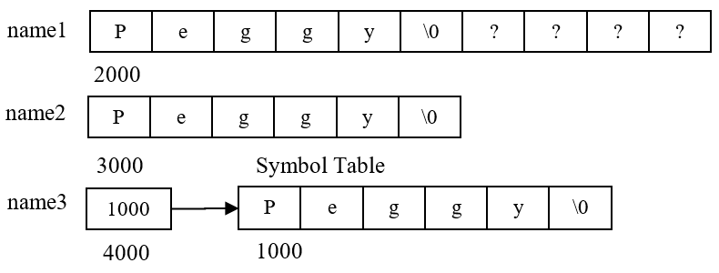
12.12 Ragged Arrays – Pointers and Symbol Table Diagram
All three variable declarations in accomplish the same thing in three different ways

Slide 74
12.12 Ragged Arrays – Example Explanation
name3 uses least amount of memory
name1 is worst because of wasted elements
name2 isn’t too bad except that the symbol table still contains the string literal and now a copy as well

Slide 75
12.12 Ragged Arrays – Creation
Can extend this efficient use of memory further by using an array of pointers, a ragged array
const char * names[6] =
{
"Bill",
"Bob",
"George"
};

Slide 76
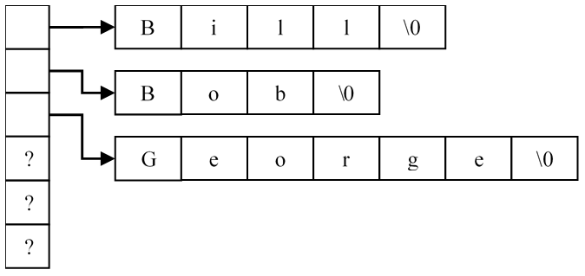
12.12 Ragged Arrays – Diagram
An array of six character pointers is declared
First three are initialized to the addresses of string literals

Slide 77
12.12 Ragged Arrays – Additional Examples
On previous slide, right edges of the literals are not even (i.e., ragged array)
Especially useful in the creation of a constant array of string literals
const char * ranks[] = { "Ace", "Deuce", "Trey", "Four", "Five",
"Six", "Seven", "Eight", "Nine", "Ten",
"Jack", "Queen", "King" };
const char * suits[] = { "Spades", "Diamonds", "Clubs", "Hearts" };

Slide 78
12.12 Ragged Arrays – Additional Examples Explanation
The two ragged arrays are useful in a variety of programs that use a standard deck of cards
It makes sense because
Values will never change
Takes up the least amount of memory
Keeps all values together

Slide 79
12.13 Dynamic 2D Arrays – Beginning Steps
Simplest way to create dynamic ragged array is if we know the number of strings to be stored
If known, we can create a character pointer array of the correct size
Necessary to declare a two star character pointer
Use new to allocate the dynamic character pointer array

Slide 80
12.13 Dynamic 2D Arrays – Beginning Steps Example
char ** names = nullptr; // Two star character pointer
char * str = nullptr;
char buffer [256]; // Used in the next step
int num_names = 0;
cout << "How many names will you enter? ";
cin >> num_names;
names = new char * [num_names]; // Notice char * []

Slide 81
12.13 Dynamic 2D Arrays – Allocating Rows in Ragged Array
Assign the address of the dynamic array of characters to an element in the pointer array
for ( int i = 0; i < num_names; ++i )
{
cout << "Please enter a name: ";
cin >> buffer;
str = new char[strlen ( buffer ) + 1];
strcpy ( str, buffer );
names[i] = str; // Assign the address of the cString to
// an element in the array of pointers
}

Slide 82
12.13 Dynamic 2D Arrays – Better Algorithm Step 1
Isn’t always feasible to ask the user how many elements are needed
Another approach is shown starting below
Variable temp contains address of the array into which all of the addresses of the previously entered names are copied
int num_names = 0;
char ** names = nullptr;
char ** temp = nullptr;
char buffer [256];

Slide 83
12.13 Dynamic 2D Arrays – Better Algorithm Step 2
Allocate memory needed for temporary array
Copy all addresses associated with any previously entered names into the new array
// Create an array with room for one more pointer
temp = new char * [num_names + 1];
// Copy the addresses of any previously entered names
// to our temporary array. Notice the first time
// the loop will not execute
for ( int i = 0; i < num_names; ++i )
{
temp[i] = names[i];
}

Slide 84
12.13 Dynamic 2D Arrays – Step 2 Diagram
Notes:
Note: The diagram shows how these variables might look in memory, assuming two names have already been entered

Slide 85
12.13 Dynamic 2D Arrays – Step 2 Description
Notice temp now points to an array that is one bigger than what names points to
First two pointers of each array are pointing to the same strings
Names weren’t copied, but rather the pointers were individually assigned from one array to the other

Slide 86
12.13 Dynamic 2D Arrays – Step 3
Read in the new name
Allocate exact amount of memory needed for the name
Store address of this name at the end of the temporary array
Copy name from buffer into newly allocated memory

Slide 87
12.13 Dynamic 2D Arrays – Step 3 Example
// Read name
cout << "Enter name: ";
cin >> buffer;
// Allocate room for the newly entered string.
// Store the new address in the last element of the
// temporary array
temp[num_names] = new char [strlen ( buffer ) + 1];
// Copy the name from the buffer into the newly
// allocated space
strcpy ( temp[num_names], buffer );

Slide 88
12.13 Dynamic 2D Arrays – Step 3 Diagram

Slide 89
12.13 Dynamic 2D Arrays – Step 4 Description and Example
Clean up old array pointed to by names
Make names point to newly generated array pointed to by temp
Increment num_names
// Delete the old array holding the name pointers
delete [] names;
// Assign the address of the temporary array to our
// original pointer
names = temp;
// Increment the number of names
++num_names;

Slide 90
12.13 Dynamic 2D Arrays – Step 4 Diagram
Notes:
Note: Only the old array pointed to by names is deleted, not the strings themselves

Slide 91
12.13 Dynamic 2D Arrays – Summary
Everything is now setup for the entry of the next name
Process can be fairly memory and processor intensive
There is a lot of memory allocation and deallocation which may decrease your program speed
If you understand this process, you have a good understanding of pointers
Dynamic arrays are useful and make good use of available memory
Don’t forget to deallocate all the memory used!

Slide 92
12.13 Dynamic 2D Arrays – Cleaning Up
A common mistake students make is only deleting the array without deleting each name pointed to by the elements of the array
// Delete each name pointed to by the names array
for ( int i = 0; i < num_names; ++i )
delete [] names[i];
// Delete the array itself
delete [] names;
Notes:
Remember: A common mistake students make is only deleting the array without deleting each name pointed to by the elements of the array

Slide 93
12.14 Testing for Memory Leaks – Memory Leak Check
Visual Studio includes some functions that check for memory leaks during the debugging process
In C++ programs, the check utility can’t tell where memory leaks are introduced but can check for their existence
#define _CRTDBG_MAP_ALLOC
// Place any other #includes here
#include <crtdbg.h>
int main()
{
// Run this program using "Start Debugging"
_CrtSetDbgFlag ( _CRTDBG_ALLOC_MEM_DF | _CRTDBG_LEAK_CHECK_DF );
int * ptr = new int;
return 0;
}

Slide 94
12.14 Testing for Memory Leaks – Explanation
#define should be performed prior to any #includes
Call to _CrtSetDbgFlag should be the first line of code in main
Run the program using the Start Debugging option
When the program exits, the Output window displays existence of any memory leaks

Slide 95
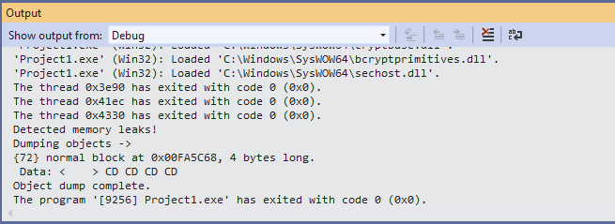
12.14 Testing for Memory Leaks – Output Window
Output window displays
“Detected memory leaks!”
The beginning address of the memory that was allocated
How many bytes were not deallocated
The data displayed in hexadecimal format

Slide 96
12.15 Function Pointers – Definition and Declaration
The instruction set for every function exists somewhere in memory
We can retrieve that address and store it in a pointer, a function pointer
Declaration of a function pointer looks similar to the function signature
// Pointer to a function that returns nothing and is passed
// nothing
void ( *fn_ptr1 ) ( );
// Pointer to a function that returns an int and is passed
// nothing
int ( *fn_ptr2 ) ( );
// Pointer to a function that returns an int and is passed
// three parameters
int ( *fn_ptr3 ) ( int, double, char[] );
Notes:
Remember: A function signature is a method for identifying a specific function based upon its name, the order and number of parameters it takes, and its return type.

Slide 97
12.15.1 Declaration – Explained
All functions whose addresses are stored in a specific pointer must have same signature
Parentheses around the asterisk and pointer name, (*fn_ptr1), are required
Without parentheses the compiler would interpret that line as a function declaration

Slide 98
12.15.1 Declaration – Dynamic Allocation
// Allocate a function pointer
int (**ptr1)() = new ( int(*) () );
// Allocate an array of five function pointers
int (**ptr2)() = new ( int(*[5]) () );
Notes:
Note: Can dynamically allocate a function pointer and also an array of function pointers, but not a function.

Slide 99
12.15.2 Retrieving a Function’s Address
Like arrays whose name references the beginning address of the array, a function’s name references its beginning address
int GetAge ( );
int main ( )
{
int ( *fn_ptr ) (); // Function pointer declaration
fn_ptr = GetAge; // Assignment of GetAge’s address
return 0;
}
int GetAge ( )
{
int age;
cout << "Enter age: ";
cin >> age;
return age;
}

Slide 100
12.15.3 Indirectly Calling a Function – Example
Options for calling the function
Use the function pointer just like the name of a function
Use asterisk to signify using a function pointer
int (*fn_ptr) ();
fn_ptr = GetAge;
// Method 1
int age = fn_ptr();
// Method 2
int age = (*fn_ptr)();

Slide 101
12.15.3 Indirectly Calling a Function – Style
Both methods shown in the example accomplish the same task
Some programmers prefer one method over the other
We prefer the first method because it is more consistently used in industry

Slide 102
12.15.4 Uses of Function Pointers – Description
Now you know how to create function pointers
Why use them?
Used in a predefined function called qsort
Sorts arrays of any type
Sorting requires being able to compare two of the elements to be sorted
cStrings and integers are compared differently
How can the same function sort different types of data?

Slide 103
12.15.4 Uses of Function Pointers – qsort
void qsort
(
void *base, // Address of array to be sorted
size_t num, // The number of elements
size_t width, // The size of each element
int ( *compare )(const void *, const void *) // Function pointer
);
A void pointer is a pointer to anything
Memory pointed to by void pointer is like a lump of clay waiting to be molded into whatever is needed
Data type size_t an unsigned int
Last parameter is a function pointer which determines how to compare two of the elements in the array
You need to include <cstdlib>

Slide 104
12.15.4 Uses of Function Pointers – qsort Example main
int main ( )
{
const char * shrooms[10] =
{
"Matsutake", "Lobster", "Oyster", "King Boletus",
"Shaggy Mane", "Morel", "Chanterelle", "Calf Brain",
"Pig's Ear", "Chicken of the Woods"
};
int nums[10] = { 99, 43, 23, 100, 66, 12, 0, 125, 76, 2 };
// The address of the array, number of elements the size of each
// element, the function pointer to compare two of the elements
qsort ( (void *)shrooms, 10, sizeof ( char * ), compare_strs );
qsort ( (void *)nums, 10, sizeof ( int ), compare_ints );
// Output sorted lists
for ( int i = 0; i < 10; ++i )
cout << shrooms[i] << endl;
for ( int i = 0; i < 10; ++i )
cout << nums[i] << endl;
return 0;
}

Slide 105
12.15.4 Uses of Function Pointers – qsort Example Compares
int compare_ints ( const void * arg1, const void * arg2 )
{
int return_value = 0;
if ( *(int *)arg1 < *(int *)arg2 )
return_value = -1;
else if ( *(int *)arg1 > *(int *)arg2 )
return_value = 1;
return return_value;
}
int compare_strs ( const void * arg1, const void * arg2 )
{
return ( stricmp ( (char *)arg1, (char *)arg2 ) );
}

Slide 106
12.15.4 Uses of Function Pointers – qsort Example Explained
Call to qsort accepts as last parameter the address of the two compare functions
qsort requires the compare function to have a specific signature
Compare function must return
Less than 0 if arg1 is less than arg2
Equals 0 if the two arguments are the same
Greater than 0 if arg1 is greater than arg2
Essentially, these are the same return values as used in strcmp

Slide 107
12.16 Problem Solving Applied – Step Wise Refinement
Step-wise refinement is an extremely effective programming technique
Another useful technique is to draw pictures to help understand and visualize the process
Both techniques will be demonstrated as we develop a function to delete a specific cString from a dynamic array
First part of the step-wise refinement process is to develop a very general algorithm
Don’t go into much detail at this point because the algorithm will be expanded

Slide 108
12.16 Problem Solving Applied – High Level Algorithm
Step 1: Find index of stock to be deleted
If target is found
Step 2: Allocate new array for stock pointers
Step 3: Make new array point to any stocks located before
the one to delete
Step 4: Deallocate desired stock
Step 5: Make new array point to any stocks located after the
one deleted
Step 6: Deallocate stock array and assign stock pointer to
new array
Step 7: Decrement number of stocks
Else
Step 8: Display error message
End If

Slide 109
12.16 Problem Solving Applied – Expansion
Once the algorithm has been developed, expand each step as necessary into appropriate pseudocode
Some pieces of the algorithm may not warrant drawing the diagram before developing pseudocode
First step of the delete algorithm is a standard sequential search

Slide 110
12.16 Problem Solving Applied – Step 1 Pseudocode
found = false
While found_index is less than number of stocks and target not found
If stocks [found_index] is equal to target
found = true
Else
Increment found_index
End If
End Loop

Slide 111
12.16 Problem Solving Applied – Step 2
Next step is more complicated and deals directly with pointers
Draw the diagram of what you are trying to accomplish in relation to Step 2 of the general algorithm

Slide 112
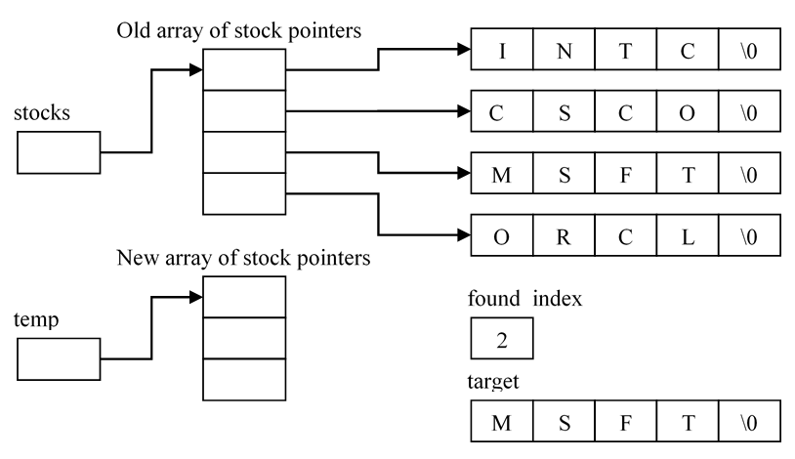
12.16 Problem Solving Applied – Step 2 Diagram

Slide 113
12.16 Problem Solving Applied – Step 2 Pseudocode
Pseudocode for the second step may be fairly trivial, but creating the diagram allows developing this algorithm in a step-wise manner
If target is found
Allocate new array of stock pointers one
smaller than the current number of stocks

Slide 114
12.16 Problem Solving Applied – Step 3
Third step requires copying the individual pointers from old array into the new array
Copying process stops when the target stock’s index is reached

Slide 115
12.16 Problem Solving Applied – Step 3 Diagram

Slide 116
12.16 Problem Solving Applied – Step 3 Pseudocode
While counter is less than found_index
temp [counter] = stocks [counter]
Increment counter
End Loop

Slide 117
12.16 Problem Solving Applied – Step 4 Diagram
Deallocate stocks [counter] which points to the target stock
Notes:
Note: Fourth step requires deleting the target stock.
Note: The pseudocode is not very exciting, but it is an extremely important step.

Slide 118
12.16 Problem Solving Applied – Step 5 Diagram
Notes:
Note: In Step 5 the pointers to the stocks after the deleted stock are copied into the new array

Slide 119
12.16 Problem Solving Applied – Step 5 Pseudocode
Notice similarities between Step 5 and Step 3
While counter is less than number of stocks
temp [counter] = stocks [counter + 1]
Increment counter
End Loop

Slide 120
12.16 Problem Solving Applied – Step 6 Diagram
Notes:
Note: Step 6 deallocates the old pointer array and assign stocks pointer to the new array

Slide 121
12.16 Problem Solving Applied – Step 6 Pseudocode
Deallocate old array
Make the stocks pointer point to new array
Final Thoughts
While the process just presented may seem like a lot of work, experience shows that programs developed using step-wise refinement and related diagrams are usually developed in less time and have fewer bugs
Notes:
Note: It would be a good exercise to finish the CRUD operations started in the last couple of sections with Create (Add), Delete, and Purge by adding functions like Search (Retrieve) and Display.

Slide 122
12.17 C The Differences – NULL
C uses a predefined constant, NULL, to initialize pointers
Using 0 would still work, but its use is discouraged in C programming circles
Since NULL is predefined but not a reserved word, its definition is located in a header file
Many C header files, including <stdio.h>, have a definition for NULL

Slide 123
12.17.1 C The Differences – Dynamic Memory Allocation
The new function is not available in C
C uses malloc to dynamically allocate memory
The new operator is nothing more than a wrapper or shell around the malloc function
int * ptr1 = new int; // C++
int * ptr1 = (int *)malloc ( sizeof ( int ) ); /* C */
char * str = new char[num_elements]; // C++
char * str = (char *)malloc ( sizeof ( char ) * num_elements ); /* C */
char ** star_star = new char *[15]; // C++
char ** star_star = (char **)malloc ( sizeof ( char * ) * 15 ); /* C */

Slide 124
12.17.1 C The Differences – malloc
Only parameter to malloc is the number of bytes to be allocated
If allocating an array, specify the size of each element and then multiply it by the number of desired elements
Pointer returned from malloc must be type cast to whatever target type is needed
malloc returns a void pointer
To use malloc include <stdlib.h>

Slide 125
12.17.1 C The Differences – calloc and realloc
Function calloc allows initializing the memory to all zeros
Function realloc allows you to change the size of an allocated block of memory

Slide 126
12.17.2 C The Differences – Dynamic Memory Deallocation
The free function deallocates any memory allocated with malloc
Difference between free and delete
Some older specifications for free state that the program will crash if the pointer is null when an attempt to deallocate memory is made
Newer versions of free do not have this limitation
Never mix language memory allocation and deallocation
If writing a C program, use malloc and free
If writing a C++ program, use new and delete
if ( ptr != NULL )
free ( ptr );

Slide 127
12.17.3 C The Differences – Memory Leak Detection
Double-clicking on the memory leak error message in the Output window in a C program transfer's the cursor to the actual malloc call within the code whose memory didn’t get freed

