Slide 1
Chapter 13 User Defined Types

Slide 2
13.1 The typedef Statement – Syntax
typedef
Allows you to create an alternative name or synonym for an existing data type
Simplifies name of complicated data types
Syntax
typedef <data-type> <synonym>;

Slide 3
13.1 The typedef Statement – Examples
typedef unsigned long ULONG;
typedef unsigned short int USHORT;
typedef char * PCHAR;
ULONG salary = 100000;
USHORT age = 21;
PCHAR str = new char[15]; // Allocate an array of 15 characters
delete [] str;

Slide 4
13.1 The typedef Statement – With Pointers
Using typedefs with pointers may hide too many details
typedef char * PCHAR;
PCHAR * str = new PCHAR[15]; // Array of 15 character pointers
// -- Equivalent To --
char ** str = new char * [15];
delete [] str;
Notes:
Note: Notice that the declaration of str hides the fact that str is a pointer. It just seems odd to delete a variable that doesn’t look like a pointer.

Slide 5
13.2 Enumerated Data Types – Syntax
Associates list of identifiers with a type name
Variable of this new enumerated type has the values specified in the identifier list
Syntax
enum <enum-name> { <identifier-list> };
<enum-name>
User specified name
<identifier-list>
Comma delimited list of values considered legal for the data type

Slide 6
13.2 Enumerated Data Types – Creating enum Example
enum DaysOfWeek
{
SUNDAY, MONDAY, TUESDAY, WEDNESDAY,
THURSDAY, FRIDAY, SATURDAY
};
enum TrafficLightColor { RED, YELLOW, GREEN };
enum ButtonState { OFF, ON };
Underlying integer value starts at 0 (in above example OFF equates to 0 and ON equates to 1)

Slide 7
13.2 Enumerated Data Types – Specifying Values Example
enum CardRanks
{
ACE = 1, DEUCE, TREY, FOUR, FIVE, SIX,
SEVEN, EIGHT, NINE, TEN, JACK, QUEEN, KING
};
enum Coins { PENNY = 1, NICKEL = 5, DIME = 10, QUARTER = 25 };

Slide 8
13.2 Enumerated Data Types – Using enum Example
DaysOfWeek today;
DaysOfWeek week[7] =
{
SUNDAY, MONDAY, TUESDAY, WEDNESDAY,
THURSDAY, FRIDAY, SATURDAY
};
DaysOfWeek * new_day = new DaysOfWeek;
DaysOfWeek best_day = SATURDAY;

Slide 9
13.2 Enumerated Data Types – Printing an enum
Possible to print enumerated variables, displaying the underlying value (not the identifier)
DaysOfWeek best_day = SATURDAY;
cout << best_day << endl;
// Output
6

Slide 10
13.2 Enumerated Data Types – Printing with Ragged Array
While not built into C++, still possible to display the desired text
enum DaysOfWeek
{
SUNDAY, MONDAY, TUESDAY, WEDNESDAY,THURSDAY, FRIDAY, SATURDAY
};
const char * DaysOfWeekText[] = { "Sunday", "Monday", "Tuesday", "Wednesday",
"Thursday", "Friday", "Saturday" };
DaysOfWeek best_day = SATURDAY;
cout << DaysOfWeekText[best_day] << endl;
// Output
Saturday
Example uses a ragged array, with each element matching a corresponding identifier in the enum
Instead of printing the enum identifier, printed the text from the array using the identifier as index into the ragged array
Obviously this only works if you do not specify specific values for the enum identifiers

Slide 11
13.2 Enumerated Data Types – Benefits
Adds safety because of the extra type checking they provide
Only values specified in the enum declaration can be used in variables of that type
Increase program readability
Example on the following slides demonstrates how much more readable code becomes when using enums
Identifiers usually created using all uppercase letters

Slide 12
13.2 Enumerated Data Types – Menu Example
enum MenuItems { ADD = 1, DELETE, EDIT, EXIT };
int menu_choice;
cout << "1) Add a new student\n"
<< "2) Delete a student\n"
<< "3) Edit a student's info\n"
<< "4) Exit\n\n";
cout << "Enter menu choice: ";
cin >> menu_choice;

Slide 13
13.2 Enumerated Data Types – Menu Example Continued
if ( menu_choice >= 1 && menu_choice <= 4 ) // Verify correct values
{
// Notice the type cast
switch ( static_cast<MenuItems> (menu_choice) )
{
case ADD:
// Add routines
break;
case DELETE:
// Delete routines
break;
case EDIT:
// Edit routines
break;
case EXIT:
// Exit routines
break;
default:
// Error routines
}
}

Slide 14
13.3 Structures – Syntax
Encapsulating variables of any type into one UDT
Also referred to as a record
Every variable of this type holds one record
Syntax
struct <struct-name>{ <data-members> };

Slide 15
13.3 Structures – Definition
The definition specifies the type, not a request for memory
Prior to C++ 11 data members could not be assigned initial values in the struct definition
struct Student
{
int id;
char fname[25];
char lname[25];
char gender;
float gpa;
};
struct Student
{
int id = 0;
char fname[25] = "";
char lname[25]{ '\0' };
char gender;
float gpa = 0.0F;
};
Notes:
Note: You can use either the = or { } form to specify default values. However, it is illegal to use the parenthetical form.

Slide 16
13.3.1 Nested Structures – Example
struct Date
{
short month;
short day;
short year;
};
struct Student
{
int id;
char fname[25];
char lname[25];
char gender;
float gpa;
Date admit_date; // Nested structure
};
struct Homework
{
short hw_id;
Date due_date; // Nested structure
Student submitted_by; // Nested structure
Date submit_date; // Nested structure
short score;
};
Must be defined before use
Date defined before used in Student
Student and Date before Homework

Slide 17
13.3.2 Structure Variables
Student student;
Student cst126[20];
Student * student_ptr = new Student;
Student straight_a = { 1, "Ima", "Smarty", 'F', 4.0F, {9, 15, 2007} };
Student avg_student{ 2, "Jon", "Kelley", 'M', 2.5F, 9, 25, 2010 };
Last two lines initialize a structure variable
Values must be in the order in which the data members were specified in the structure definition
Nested curly braces are not necessary, but they do give a more visual indication that we are initializing the values in the nested structure
Last example uses the newer fully uniform type initialization

Slide 18
13.3.3 Accessing the Data Members – Dot Operator
Specifies member on right of the operator belongs to structure variable on the left
// Example 1
student.id = 2;
strcpy ( student.fname, "Drew" );
// Example 2
cst126[0].id = 3;
strcpy ( cst126[0].fname, "Patty" );

Slide 19
13.3.3 Accessing the Data Members – Arrow Operator
Older deprecated method, Don’t Do This
Student * student_ptr = new Student;
(*student_ptr).id = 4;
Current practice is to use the arrow operator
student_ptr->id = 4;

Slide 20
13.3.3 Accessing the Data Members – Nested Structures
Student straight_a = { 1, "Ima", "Smarty", 'F', 4.0F, {9, 15, 2007} };
straight_a.admit_date.year = year;
Student cst126[20];
cst126[0].admit_date.day = 10;
Student * student_ptr = new Student;
student_ptr->admit_date.month = 9;
delete student_ptr;

Slide 21
13.3.4 Structure Variable Manipulation
Can be passed by any method
Assignment
Performs a member-wise copy
Member-wise copy
Duplicates contents of the data members by performing a bitwise replication of the variable

Slide 22
13.3.5 Shallow Copy Versus Deep Copy – Shallow Copy Defined
A member-wise copy can cause problems when a structure has pointers as data members
Assignment between two structures causes the addresses in the pointers to be copied (not the data pointed to)
Shallow copy
Two pointers pointing to the same piece of memory as the result of a member-wise copy

Slide 23
13.3.5 Shallow Copy Versus Deep Copy – Shallow Copy Example
struct Person
{
int id;
char * fname;
};
Person var1, var2;
var1.id = 4;
var1.fname = new char[5];
strcpy ( var1.fname, "Mike" );
var2 = var1; // Shallow copy
After the assignment of var1 into var2, the resulting member-wise/shallow copy causes both pointers to be pointing to "Mike"

Slide 24
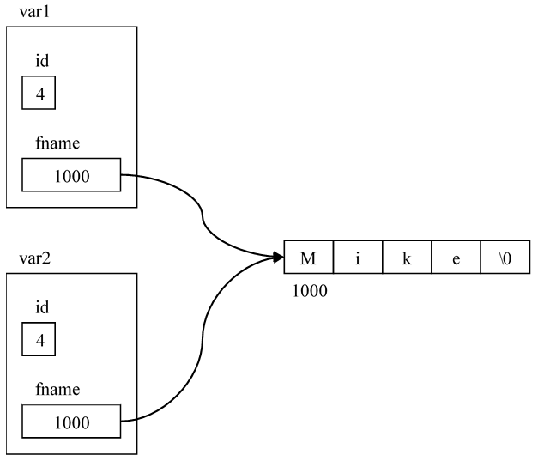
13.3.5 Shallow Copy Versus Deep Copy – Shallow Copy Diagram

Slide 25
13.3.5 Shallow Copy Versus Deep Copy – Shallow Copy Problem
Second line of code below causes the program to crash – its already been deallocated
delete [] var1.fname;
delete [] var2.fname;
Solution to above problem is to perform a deep copy
Deep Copy
A deep copy allocates additional memory for the second variable’s pointer and then copies the contents of fname into the newly allocated memory

Slide 26
13.3.5 Shallow Copy Versus Deep Copy – Deep Copy Example
struct Person
{
int id;
char * fname;
};
Person var1, var2;
var1.id = 4;
var1.fname = new char[5];
strcpy ( var1.fname, "Mike" );
// Member-wise copy, does member-wise copy for all other data
var2 = var1;
var2.fname = new char[strlen ( var1.fname ) + 1]; // Deep copy
strcpy ( var2.fname, var1.fname ); // Deep copy

Slide 27
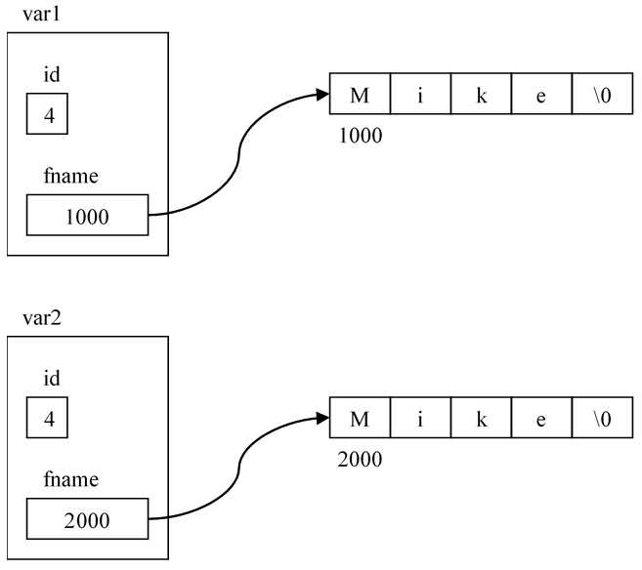
13.3.5 Shallow Copy Versus Deep Copy – Deep Copy Diagram

Slide 28
13.4 Unions – Characteristics
Defines data members like a structure does
Stores one value in memory, regardless of how many members are specified
When created, memory is allocated to hold the largest data member

Slide 29
13.4 Unions – Example
struct SalesPay
{
float base;
float commission;
double monthly_sales;
};
struct HourlyPay
{
float wage;
float hours;
};
union PayType
{
double salary;
HourlyPay hourly_wage;
SalesPay sales;
};
What is the size of PayType?
The sizeof the union is the largest data type (SalesPay) or 16 bytes

Slide 30
13.4 Unions – Assigning Data
PayType pay;
pay.hourly_wage.wage = 9.00;
pay.hourly_wage.hours = 80;
Correct union data member
cout << "Total pay: "
<< pay.hourly_wage.hours
* pay.hourly_wage.wage
<< endl;
// Output
Total pay: 720
Incorrect union data member
cout << "Base pay: "
<< pay.sales.base
<< "\nCommission: "
<< pay.sales.commission
<< endl;
// Output
Base pay: 9
Commission: 80
Notes:
Remember: In a union all data members occupy the same piece of memory. Accessing the wrong data members causes the data to be interpreted incorrectly.

Slide 31
13.4 Unions – Using a Flag Example
A union and a flag are used together to determine which data member of the union was used
enum EmpType { MANAGER, WORKER, SALESPERSON };
struct Employee
{
char name[35];
char ssn[12];
EmpType flag; // Enum data type
PayType wages; // Union data type
};
Employee sales[15];
cout << "Enter employee type (0 = Manager, 1 = Worker, "
<< "2 = Salesperson): ";
cin >> temp;
sales[i].flag = static_cast <EmpType>(temp);
Notes:
Note: You cannot read an enum using cin, must be read as primitive data type and the type_cast to the enum type.

Slide 32
13.4 Unions – Using a Flag Example Continued
switch ( sales[i].flag )
{
case MANAGER:
cout << "Enter the manager's salary: ";
cin >> sales[i].wages.salary;
break;
case WORKER:
cout << "Enter the worker's hourly rate: ";
cin >> sales[i].wages.hourly_wage.wage;
cout << "Enter the worker's hours: ";
cin >> sales[i].wages.hourly_wage.hours;
break;
case SALESPERSON:
cout << "Enter the salesperson's base salary: ";
cin >> sales[i].wages.sales.base;
cout << "Enter the salesperson's commission: ";
cin >> sales[i].wages.sales.commission;
cout << "Enter the salesperson's monthly sales: ";
cin >> sales[i].wages.sales.monthly_sales;
break;
}

Slide 33
13.4 Unions – Using a Flag Example Explained
Previous example determined the type of Employee to be entered and then used a switch statement to enter the correct data depending upon the specified type
Pairing a flag and union is a common practice to ensure the appropriate use of the union’s data members

Slide 34
13.4 Unions – Placement in Code
Usually directly after any #includes since definitions must appear before they are used
Function declarations, which are usually global, require the UDTs to specify the types of their parameters
Another, more standard way to include UDT definitions will be discussed in the next section

Slide 35
13.5 User Defined Header Files – Description
UDT definitions must appear prior to their use, typically they will be found directly after any #includes
This is because function declarations, which are usually global, require the UDTs to specify the types of their parameters
Our programs are getting more complex
The addition of UDTs added a lot of code prior to main
Making our code more difficult to read and maintain
Solution
Create header files to store UDT definitions
Additional header file for function declarations

Slide 36
13.5 User Defined Header Files – Process
Nothing magical about creating a header file
Just a file with the extension of .h
In Visual Studio you can add one to your project by right clicking on the project’s Header Files folder and adding a new item
Doesn’t automatically allow your source code to access the information in the new header file just because its in the project
Still have to be accessed by using a #include directive

Slide 37
13.5 User Defined Header Files – Syntax Options
Syntax
#include <header_file>
#include "header_file"
First form is used to include predefined header files
Tells the compiler to look in the include directory which was created when your compiler was installed
Second form is generally used to include a user defined header file
If a path is specified in the string literal, the compiler will look in that directory for the header file
If no path is specified, the compiler will look in the current directory
If the header file is not found, the compiler will then look in the standard include file locations

Slide 38
13.5 User Defined Header Files – Example types.h
// Filename: types.h
struct SalesPay
{
float base;
float commission;
double monthly_sales;
};
struct HourlyPay
{
float wage;
float hours;
};
union PayType
{
double salary;
HourlyPay hourly_wage;
SalesPay sales;
};
enum EmpType
{
MANAGER, WORKER, SALESPERSON
};
struct Employee
{
char name[35];
char ssn[12];
EmpType flag; // Enum data type
PayType wages; // Union data type
};

Slide 39
13.5 User Defined Header Files – Example func_declarations.h
// Filename: func_declarations.h
void GetManager( double & salary );
void GetWorker( HourlyPay & hour_pay );
void GetSales( SalesPay & sales_pay );

Slide 40
13.5 User Defined Header Files – Example employee.cpp 1
// Filename: employee.cpp
#include <iostream>
using std::cout;
using std::endl;
using std::cin;
#include "types.h"
#include "func_declarations.h"
const int MAX_EMPLOYEES = 5;
Notes:
Style Note: The filenames in the example are all lowercase which provides some consistency for operating systems that are case sensitive, such as Linux. They are also named so that they are indicative of their purpose.

Slide 41
13.5 User Defined Header Files – Example employee.cpp 2
int main()
{
int temp = 0;
Employee sales[MAX_EMPLOYEES];
for (int i = 0; i < MAX_EMPLOYEES; ++i)
{
cout << "Enter employee type (0=Manager, 1=Worker, " << "2=Salesperson): ";
cin >> temp;
sales[i].flag = static_cast <EmpType>(temp);
switch (sales[i].flag)
{
case MANAGER:
GetManager(sales[i].wages.salary);
break;
case WORKER:
GetWorker(sales[i].wages.hourly_wage);
break;
case SALESPERSON:
GetSales(sales[i].wages.sales);
break;
}
}
return 0;
}

Slide 42
13.5 User Defined Header Files – Example employee.cpp 3
void GetManager(double & salary)
{
cout << "Enter the manager's salary: ";
cin >> salary;
}
void GetWorker(HourlyPay & hour_pay)
{
cout << "Enter the worker's hourly rate: ";
cin >> hour_pay.wage;
cout << "Enter the worker's hours: ";
cin >> hour_pay.hours;
}
void GetSales(SalesPay & sales_pay)
{
cout << "Enter the salesperson's base salary: ";
cin >> sales_pay.base;
cout << "Enter the salesperson's commission: ";
cin >> sales_pay.commission;
cout << "Enter the salesperson's monthly sales: ";
cin >> sales_pay.monthly_sales;
}

Slide 43
13.6 Problem Solving Applied – Description
Which UDT to use in describing the data object
Data that is common among all instances of the data object should be stored in a structure
If the description states, “the book has a title and an author and an ISBN”, a struct will be used
If the description uses an or instead of an and, use a union
If the description states, “the book is either printed or audio”, which indicates a union should be used
If there is a list of related items, such as genre types, use an enum

Slide 44
13.6 Problem Solving Applied – Example
enum Genres { HORROR, SCIFI, COMEDY, DRAMA, ACTION };
enum BookTypes { PRINTED, AUDIO };
enum PrintTypes { HARD, PAPER, DIGITAL };
struct Printed
{
int num_pages;
PrintTypes print_type;
};
struct Audio
{
int listening_time;
char narrator_name[50];
};
struct Book
{
char title[100];
char author_name[50];
char isbn[14];
Genres genre;
BookTypes book_type;
union
{
Printed print_book;
Audio audio_book;
} media;
};
Notes:
Note: The union in the Book structure is called an anonymous union. It only exists within the structure and cannot be accessed directly. The identifier media is a variable of that union type.

Slide 45
13.7 C The Differences – UDT
C has the capabilities to create user defined types as discussed in this chapter
Usage of the data types, once created, is slightly different
Doesn’t allow the name of the data type to be used directly without specifying the form of UDT used to create the data type
This technique is required regardless of the type of UDT
enum, struct, or union

Slide 46
13.7 C The Differences – UDT Examples
struct Student
{
int id;
char fname[25];
char lanme[25];
char gender;
float gpa;
};
struct Student student;
struct Student cst126[20];
typedef struct Student
{
int id;
char fname[25];
char lname[25];
char gender;
float gpa;
} STUDENT;
STUDENT student;
STUDENT cst126[20];
Using typedef allows us to simulate the functionality of C++ by letting us use the data type directly without having to specify the type of the UDT
Because of the extra work involved in having to specify the type of the UDT in C, typedefs are used much more heavily in C than in C++

