Slide 1
Chapter 14
Miscellaneous
Topics

Slide 2
14.1 Command Line Arguments – Description
When double-clicked within Windows Explorer, a file is opened by an associated program
Windows associates files with specific extensions to be opened by certain programs
How does the program know which file to open?
  The OS passes the name and path of the file to the program
  Program catches the value in an optional parameter specified in the function header of main

Slide 3
14.1 Command Line Arguments – argc and argv Definition
If multiple files are selected, each filename is passed as one row in a ragged array to the program
Number of strings passed to the program is stored in another parameter
These parameters can have any name, but usually called argc and argv
  The argc parameter contains the number of strings stored in argv
  The argc parameter refers to the argument count and argv refers to the argument vector
  First string stored in argv is the path and name of the program
Notes:
Remember: The argc parameter name refers to the argument count and the argv parameter refers to the argument vector, which is another term for an array.

Slide 4
14.1 Command Line Arguments – Simple Example
int main ( int argc, char * argv[] )
{
for ( int i = 0; i < argc; i++ )
cout << argv[i] << endl;
return 0;
}
Notes:
Remember: First string stored in argv is the path and name of the program.

Slide 5
14.1 Command Line Arguments – Command Line
Command line
  Textual interface into an operating system
  Commands that manipulate the operating system are entered at the command prompt
To see in Windows
  Go to Start menu and type cmd
  OS uses a space to separate each string and passes that information to the program, along with the number of strings

Slide 6
14.1 Command Line Arguments – Command Line Example
int main ( int argc, char * argv[] )
{
float average;
int sum = 0;
if ( argc > 1 ) // Valid number of arguments?
{
// Loop through arguments ignoring the first which is the name and path of this program
for ( int i = 1; i < argc; i++ )
{
// Convert cString to int
sum += atoi ( argv[i] );
}
// Calculate average
average = sum / (argc – 1);
cout << "\nSum: " << sum << '\n' << "Average: " << average << endl;
}
else
{ // If invalid number of arguments, display error message and usage syntax
cout << "Error: No arguments\n" << "Syntax: command_line [space delimted numbers]"
<< endl;
}
return 0;
}
// Command line execution
C:\LearnByDoing\debug>command_line 15 25 35 10 19 40
Notes:
Note: Code example shows how command line arguments can pass a series of numbers to a program

Slide 7
14.1 Command Line Arguments – Command Line Example Explained
In previous example, the number of arguments passed is checked to make sure the user supplied data to the program
  If not, an error message is displayed along with the syntax that should be used
    Common practice for programs requiring command line arguments
Can be used in the debugging process
  In Visual Studio, right click on the Project in the Solution Explorer
  Click Properties at bottom of the popup menu
  Expand Configuration Properties item select Debugging option
  Notice an area called Command Arguments
  Enter data necessary to test your program

Slide 8
14.2 Conditional Compilation – Definition
A situation that often occurs involves the need to compile the code differently depending on some condition
A mechanism to change what gets compiled, which needs to occur prior to the compiler
  This implies the preprocessor level

Slide 9
14.2 Conditional Compilation – Example
#define _CRTDBG_MAP_ALLOC
#include <iostream>
using namespace std;
#ifdef _CRTDBG_MAP_ALLOC
#include <crtdbg.h>
#endif //_CRTDBG_MAP_ALLOC
int main()
{
#ifdef _CRTDBG_MAP_ALLOC
_CrtSetDbgFlag(_CRTDBG_ALLOC_MEM_DF | _CRTDBG_LEAK_CHECK_DF);
#endif // _CRTDBG_MAP_ALLOC
char * str = new char[24];
//delete[] str;
return 0;
}
Notes:
Note: Example demonstrates how conditional compilation can be used to include the memory leak checker based upon a #define constant

Slide 10
14.2 Conditional Compilation – Other Preprocessor Directives
Directive | Description
#if | Preprocessor if statement.
#elif | Preprocessor else if statement.
#else | Preprocessor else statement.
#endif | Ending statement for all preprocessor conditional statements.
#ifdef | Checks to see if an identifier is defined. Evaluates to true if defined.
#ifndef | Checks to see if an identifier is not defined. Evaluates to true if not defined.
#define | Used to create preprocessor constants and identifiers.
#error | Stops compilation and displays an error message.

Slide 11
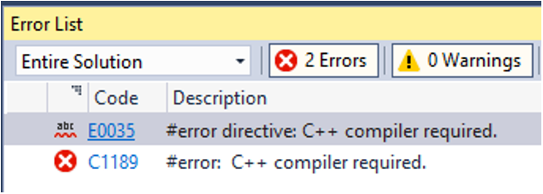
14.2 Conditional Compilation – #error Example
Tests for the existence of an identifier, __cplusplus, present in all C++ compilers
Realize there are two underscores in the identifier __cplusplus
If it is not defined, compilation stops and the error message is displayed in the Error List window
#ifndef __cplusplus
#error C++ compiler required.
#endif

Slide 12
14.3 Multiple Source Code Files – Description
We learned how to create our own header files
We have only had a single .cpp file
  As programs have grown so has the difficulty in managing and maintaining our functions in the one source code file
To add another source file to the project
  Right click on the Source Files folder in Solution Explorer
  Click Add → New Item or press Ctrl + Shift + A

Slide 13
14.3 Multiple Source Code Files – employee_input.cpp Example 1
// Filename: employee_input.cpp
// Contents: The Employee application input functions
#include <iostream>
using std::cout;
using std::cin;
#include "types.h"
void GetManager( double & salary )
{
cout << "Enter the manager's salary: ";
cin >> salary;
}
Notes:
Note: Example takes the functions developed in Chapter 13 and moves them to another source code file

Slide 14
14.3 Multiple Source Code Files – employee_input.cpp Example 2
void GetWorker( HourlyPay & hour_pay )
{
cout << "Enter the worker's hourly rate: ";
cin >> hour_pay.wage;
cout << "Enter the worker's hours: ";
cin >> hour_pay.hours;
}
void GetSales( SalesPay & sales_pay )
{
cout << "Enter the salesperson's base salary: ";
cin >> sales_pay.base;
cout << "Enter the salesperson's commission: ";
cin >> sales_pay.commission;
cout << "Enter the salesperson's monthly sales: ";
cin >> sales_pay.monthly_sales;
}

Slide 15
14.3 Multiple Source Code Files – Problem
Have included functions with a similar purpose in a single source code file
  Logical separation helps in locating specific functions as the size of your programs increase
Process may cause another issue which is easily rectified
  Including the same header file in multiple source code files
    Data types may be recognized as already defined by the compiler and linker
    Can lead to multiple definitions of the same UDT

Slide 16
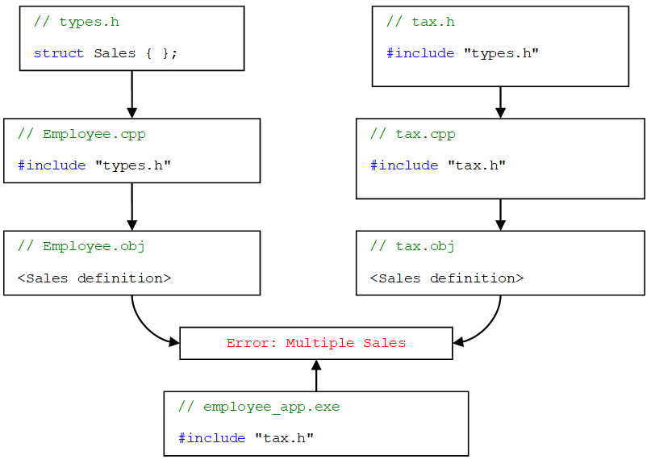
14.3 Multiple Source Code Files – Problem Diagram

Slide 17
14.3 Multiple Source Code Files – Problem Solution
When the employee_app program is compiled there are multiple definitions of the Sales type
UDT multiple definition solution
  Preprocessor guards
  #pragma once
These techniques are described in the next few slides

Slide 18
14.3.1 Preprocessor Guards – Definition
The #ifndef preprocessor directive is one of several methods to conditionally compile a section of code
  Directive causes the preprocessor to check for the definition of an associated identifier
  If the identifier is not defined, the code between the #ifndef and the ending #endif will be compiled
    Make sure to define the identifier (exactly how it is in the #ifndef) within the guards
    This will ensure the code won’t be compiled again
Notes:
Remember: The term #ifndef comes from if not defined.

Slide 19
14.3.1 Preprocessor Guards – Example
#ifndef TYPES_H // If not defined
#define TYPES_H // Define it
struct SalesPay
{
float base;
float commission;
double monthly_sales;
};
#endif // End of conditional compilation
Notes:
Style note: The identifier associated with the #ifndef can be any unique identifier. However, it is common practice to name the identifier the same as the header file. The only change is to replace the period with an underscore. This is necessary because a period is an invalid character within any C++ identifier. The identifier is usually capitalized because it is a constant.

Slide 20
14.3.2 #pragma once
Alternative to using preprocessor guards
Not a standard construct, it is supported by most compilers
An argument for using #pragma once, is that it is usually more optimized and therefore will speed up the compilation process
#pragma once
// types.h
struct SalesPay
{
float base;
float commission;
double monthly_sales;
};

Slide 21
14.4 Macros – Definition
Macros
  Sections of code which replace the macro identifier during preprocessor execution
  Created using #define
Using a #define to create a constant, in essence, creates a macro
  Identifier associated with #define is replaced with the supplied value
Not limited to the simple replacement of an identifier with a constant
More complicated code fragments can be written, including passing parameters

Slide 22
14.4 Macros – Example
  // Macro definition
  #define MAX( a, b ) a > b ? a : b
  // Using the macro
  cout << "Largest value: " << (MAX ( 10, 15 ))
  << endl;
  // Output
  Largest value: 15
It is an error to place a space between the macro identifier and opening parenthesis of the definition’s parameter list
  // Macro expansion
  cout << "Largest value: " << (10 > 15 ? 10 : 15) << endl;

Slide 23
14.4 Macros – One Potential Problem
  #define CUBE( a ) a * a * a
  int main ( )
  {
  int x = 2;
  // 2 cubed = 8
  cout << CUBE ( x ) << endl;
  // 3 cubed = 27
  cout << CUBE ( x + 1 ) << endl;
  return 0;
  }
Cause of the problem
  Order of operations is the root of the unexpected output
  // Output
  8
  7
  // Macro Expansion
  cout << x * x * x << endl;
  cout << x + 1 * x + 1 * x + 1 << endl;

Slide 24
14.4 Macros – Problem Solution
To correct the problem
  Make liberal use of parentheses
// Macro definition
#define CUBE( a ) ((a) * (a) * (a))
// Macro expansion using x + 1
cout << ((x + 1) * (x + 1) * (x + 1)) << endl;
// Output
27

Slide 25
14.4 Macros – Line Continuation
Macro may need to span multiple lines to help with code readability and maintainability
  Might cause problems
Line Continuation Character (\)
  Used to continue a line of code to the next line
  Line continuation character can be used at anytime
#define GETRANDOM( max ) \
(rand() % (max))
int main ( )
{
cout << GETRANDOM ( 100 ) << endl;
return 0;
}

Slide 26
14.4.1 Advantages and Disadvantages – Speed Versus Size
When calling a function a few values, such as the return pointer and state of all local variables, are pushed onto the stack
  Since this is done during runtime, program execution speed becomes negligibly slower
Macros are expanded during preprocessor execution and don’t push anything on the stack resulting in faster execution
  Macros still participate in the modularity of your program
Large macro used many times increases size of the executable file
  Macros are usually kept relatively small

Slide 27
14.4.1 Advantages and Disadvantages – Common Errors
Syntax errors appear on the line where the macro is used, not where defined
Can’t use the debugger to step into a macro
No type checking is done on the parameters of a macro
Style note
  Common error is to place a semicolon at the end of the of the macro definition
  Causes problems when the macro is embedded within another statement
Because of disadvantages associated with macros, using functions is preferred over using macros

Slide 28
14.5 Storage Classes – Definition
Storage classes
  Regulate lifetime, visibility or memory placement of a variable
Storage classes in C++
  register, static, extern
  Other storage classes include mutable and thread_local which are not discussed in this book
Type qualifiers
  Closely related to storage classes
  Effects the variables type not its storage, giving it additional attributes
  const and volatile

Slide 29
14.5 Storage Classes – register Storage Class
register
  Requests the variable be placed into a machine register to increase execution speed
  VS tries to do this when certain optimizations are specified within the compiler
Optimization
  Allows the compiler to decide upon a course of action based on the environment settings
This storage class is listed as deprecated in the C++17 standard

Slide 30
14.5 Storage Classes – volatile Type Qualifier
volatile
  Tells the compiler not to optimize a particular variable
Tells the system to retrieve the variable from memory on every access and not to use the one that may be cached
Might not be that important for most systems, but is vital in an embedded system where a variable might be changed by a piece of hardware

Slide 31
14.5.1 static – Definition
Accustomed to the fact that when a function ends, all local variables cease to exist
  If the function is called again, the variables are recreated
static
  Specifies that while the variable has local scope, it exists for the lifetime of the program
  If a static variable is not explicitly initialized, it is initialized automatically to zero

Slide 32
14.5.1 static – Rules and Declaration
  static int counter = 0;
Can be used with any data type and arrays
static variables follow scoping rules
  Only accessible by the function in which it is declared
  Exists after the function ends

Slide 33
14.5.1 static – Simple Example
Many uses of the static storage class
One of the more common uses is to keep track of the number of times a specific function is called
  for ( int i = 0; i < 5; i++ )
  TestStatic();
  void TestStatic()
  {
  static int counter;
  cout << counter++ << " ";
  }
  // Output
  0 1 2 3 4

Slide 34
14.5.1 static – StrTok Example main
int main ( )
{
char sentence[] = "This is a test.";
char * str;
str = StrTok ( sentence, ' ' );
while ( str != nullptr )
{
cout << str << endl;
str = StrTok ( nullptr, ' ' );
}
return 0;
}

Slide 35
14.5.1 static – StrTok Example Function Definition
char * StrTok ( char * str, char delimeter )
{
static char * current_pos = nullptr;
char * temp = nullptr;
if ( str != nullptr )
current_pos = str;
temp = current_pos;
if ( temp != nullptr )
{
current_pos = strchr ( current_pos, delimeter );
if ( current_pos )
{
*current_pos = '\0';
current_pos++;
}
}
return temp;
}

Slide 36
14.5.2 extern – Definition
Global variables only visible to functions within the same code file, have file scope
Functions that need to access variables with file scope declared in another file need to specify the variable is declared outside of, or external to, the current file
extern
  Tells compiler that a variable is declared outside of the current file scope
  Linker becomes responsible for resolving its location

Slide 37
14.5.2 extern – Example
// Filename: main.cpp
int file_scope_var = 0;
void other_func ( );
int main ( )
{
file_scope_var = 10;
other_func ( );
return 0;
}
// Filename: external_file.cpp
#include <iostream>
void other_func ( )
{
extern int file_scope_var;
std::cout << file_scope_var
<< std::endl;
}
// Output
10

Slide 38
14.5.2 extern – Example Explained
The variable file_scope_var is brought into the scope of the function other_func
Because the variable is specified as extern only other_func has access to the variable in external_file.cpp
Two options if other functions need access
  Each function has to specify that file_scope_var is declared external to current scope
  External specification has to be done at the file level of external_file.cpp
Notes:
Style note: Global or file scope variables should only be used when it is absolute necessary. There are situations that require the use of these variables so it is important to learn how to use them, but only use them when truly warranted.

Slide 39
14.6 Bitwise Operations
Many times it is useful to manipulate the individual bits of a piece of data
Can increase efficiency of memory resources as well as CPU usage
Following slides discuss the mechanics of bitwise manipulations and demonstrate some of their practical applications

Slide 40
14.6.1 Bitwise Operators – Options
Logical operators have bitwise counterparts
  There are a few other bitwise operators
Operator | Description
~ | Bitwise NOT. Reverse the bit. A 1 results in a 0 and a 0 results in a 1.
>> | Bitwise SHIFT RIGHT. Shift all bits to the right by the specified number of bits.
<< | Bitwise SHIFT LEFT. Shift all bits to the left by the specified number of bits.
& | Bitwise AND. The two bits must be 1s to result in a 1.
^ | Bitwise XOR. The two bits must be different to result in a 1.
| | Bitwise OR. The two bits must be 0s to result in a 0.
All operators are binary operators with the exception of the NOT (~)
Operators are listed in order of precedence from highest to lowest

Slide 41
14.6.1 Bitwise Operators – Example
int i = 0b1010'1011'1010'1011; //0xABAB
int j = 0b1010'1011'1100'1101; //0xABCD
int result;
result = i & j; //0000 0000 0000 0000 1010 1011 1000 1001
result = i | j; //0000 0000 0000 0000 1010 1011 1110 1111
result = i ^ j; //0000 0000 0000 0000 0000 0000 0110 0110
result = ~i; //1111 1111 1111 1111 0101 0100 0101 0100
result = i >> 8; //0000 0000 0000 0000 0000 0000 1010 1011
result = i << 8; //0000 0000 1010 1011 1010 1011 0000 0000
Notes:
Remember: The ‘ (digit separators) is a C++14 addition for separating large numbers

Slide 42
14.6.1 Bitwise Operators – Example Explained
Bitwise operators is applied to each bit within the operands
Shift left and shift right symbols are also used with cout and cin
  If embedding any bitwise operations in an input or output statement use parentheses to avoid incorrect data or syntax errors
  These operators always shift in zeros no matter the direction they are shifting

Slide 43
14.6.2 Bit Fields – Description and Syntax
Bit field (or bit struct)
  Allows programmer to specify a structure member is to occupy only a certain number of bits in an integral type
Syntax
  struct <struct-name>
  {
  <integral-type> <field1> : <number-bits>;
  <integral-type> <field2> : <number-bits>;
  ...
  };

Slide 44
14.6.2 Bit Fields – Definition Example
struct IPPacketHeader
{
unsigned int version : 4;
unsigned int net_header_length : 4;
unsigned int type_service : 8;
unsigned int packet_length : 16;
unsigned int id_tag : 16;
unsigned int fragment_ability : 3;
unsigned int fragment_offset : 13;
unsigned int time_to_live : 8;
unsigned int protocol : 8;
unsigned int check_sum : 16;
unsigned int source_ip : 32;
unsigned int dest_ip : 32;
};
Notes:
Note: The bit structure shown in the example is used to hold the header information for an IPv4 network packet.

Slide 45
14.6.2 Bit Fields – Definition Example Explained
Bit structure on the previous slide holds the header information for an IPv4 network packet
Visual Studio, running on Intel’s architecture, places individual bits as shown on the next slide
Each compiler and architecture may store the information differently

Slide 46
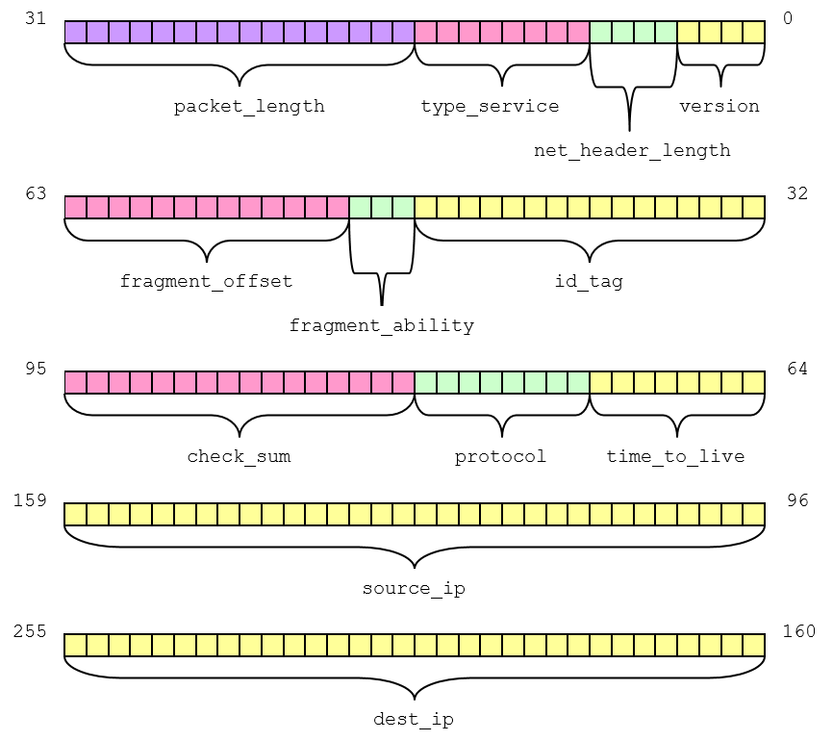
14.6.2 Bit Fields – IPv4 Packet Diagram

Slide 47
14.6.2 Bit Fields – Anonymous Field
Anonymous field
  A field without a name, usually used to align subsequent fields at particular bit boundary
Bit boundary
  Skipping a specified number of bits
Unit Boundary
  Skips to the beginning of the next specified unit, block of memory
  Must be specified as a zero length field
Following example shows a bit structure using an anonymous field with a unit boundary alignment
  struct Anonymous
  {
  unsigned short field1 : 4;
  unsigned short field2 : 10;
  unsigned short : 0;
  unsigned short field3 : 16;
  };

Slide 48
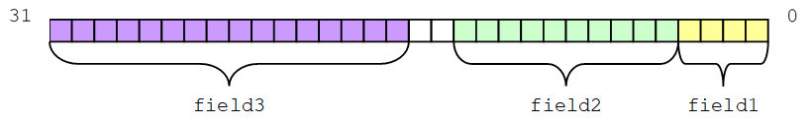
14.6.2 Bit Fields – Anonymous Field Diagram
Memory layout of the bit structure from previous slide
Size of each block of memory (unit) is determined from the size of the member's data type in the bit structure

Slide 49
14.6.3 Masking – Definition
Masking
  Process of extracting information from a larger set of data using an operator and another piece of data
Each operator has its own unique properties to help isolate specific bits
  _CrtSetDbgFlag(_CRTDBG_ALLOC_MEM_DF | _CRTDBG_LEAK_CHECK_DF);
  Above example uses the masks _CRTDBG_ALLOC_MEM_DF and _CRTDBG_LEAK_CHECK_DF to set specific bits in the parameter passed to the function

Slide 50
14.6.3 Masking – Bitwise OR
To set a bit to a 1, use the bitwise OR (|) operator and a mask that has the single bit set as well
Setting a Bit
  unsigned short result = 0; // result = 0000 0000 0000 0000
  result = result | 2; // binary 2 = 0000 0000 0000 0010
  // ------------------------------
  // result = 0000 0000 0000 0010
Accomplish turning on multiple bits by applying the correct mask
Setting Multiple Bits
  unsigned short result = 10; // result = 0000 0000 0000 1010
  result = result | 5; // binary 5 = 0000 0000 0000 0101
  // ------------------------------
  // result = 0000 0000 0000 1111
Notes:
Remember: Both terms “set a bit” and “turning on a bit” means to turn the bit to a 1.

Slide 51
14.6.3 Masking – Bitwise AND
Turning bits off
  Accomplished same way except bitwise AND (&) operator is used with a zero mask
Turning off a specific bit
  unsigned short result = 15; // result = 0000 0000 0000 1111
  result = result & 0xFFFB; // binary 65531 = 1111 1111 1111 1011
  // ----------------------------------
  // result = 0000 0000 0000 1011
Notes:
Remember: Turning a bit off or clearing means changing its state to a zero.

Slide 52
14.6.3 Masking – Bitwise XOR
Toggling bits
  Accomplished using bitwise XOR (^) operator
Toggling Bits
  unsigned short result = 15; // result = 0000 0000 0000 1111
  result = result ^ 4; // binary 4 = 0000 0000 0000 0100
  // ------------------------------
  // result = 0000 0000 0000 1011

Slide 53
14.6.3 Masking – Example
#define STUDENT 0
#define FACULTY 2
#define ADMIN 4
int main ( )
{
unsigned char permissions = FACULTY | ADMIN;
DisplayPermissions ( permissions );
return 0;
}
void DisplayPermissions ( char permissions )
{
cout << "You have the following permissions:\n";
if ( permissions & STUDENT )
cout << "\tStudent" << endl;
if ( permissions & FACULTY )
cout << "\tFaculty" << endl;
if ( permissions & ADMIN )
cout << "\tAdministrator" << endl;
}
Notes:
Note: Example sets-up a user with multiple permissions. Using bitwise operators and masking allows assigning multiple access levels while using little memory. You can specify up to eight different permission levels in a single character. If you were to use a short you could have as many as 16 permissions.

Slide 54
14.6.3 Masking – Endian
Another situation arises when converting between big-endian format to little-endian format
Little-endian
  Writes information to memory least significant byte (little end) first
Big-endian
  Writes information with the most significant byte (big end) first
Intel based computers use little-endian
Motorola typically uses big-endian formats
ARM are configurable to use either format
Converting between formats could be accomplished by reversing the bytes as shown on next page
Notes:
Note: Terms from Gulliver’s Travels where people open their soft-boiled eggs from the big end while others open their eggs from the little end

Slide 55
14.6.3 Masking – Endian Conversion Example
char result[50];
unsigned short number = 0xFBA4;
unsigned short temp = number;
itoa ( number, result, 2 );
cout << result << endl;
number &= 0x00FF; // Clear out MSB
number <<= 8; // Shift LSB into MSB
temp &= 0xFF00; // Clear out LSB
temp >>= 8; // Shift MSB into LSB
number |= temp; // Put the two bytes back together
itoa ( number, result, 2 );
cout << result << endl;

Slide 56
14.6.3 Masking – Summary
Bit manipulations no way limited to the few examples shown
Bit manipulations may save a significant amount of memory and processing time
This is especially true when dealing with embedded systems platforms

Slide 57
14.7 Recursion – Definition
Recursive function
  Function that calls itself
  Can also refer to a function that calls another function that already exists on the call stack
Can always be replaced with iteration
Terminating condition
  A condition that once met will stop the recursive calls
  Starts the process of unwinding the call stack
Reducing clause
  Alters a parameter so that it continues to approach the terminating condition

Slide 58
14.7 Recursion – Algorithms
Some algorithms more easily written using recursion
When the reducing clause produces something that is essentially the same before as well as after the reducing clause, a solution involving a recursive algorithm works well

Slide 59
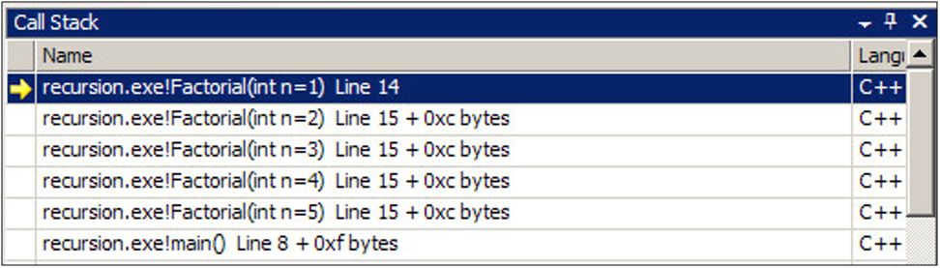
14.7 Recursion – Call Stack
If Visual Studio is not showing you the value of your parameters on the call stack
  Right click and select Show Parameter Values
This is an extremely valuable debugging tool for recursive functions

Slide 60
14.7 Recursion – Factorial Example
int main ( )
{
cout << Factorial ( 5 ) << endl;
return 0;
}
int Factorial ( int n )
{
if ( n != 1 ) // Terminating condition
{
// Recursive call with reducing clause
n = Factorial ( n - 1 ) * n;
}
return n;
}
// Output
120

