Slide 1
Chapter 16 Introduction to Object-Oriented Programming

Slide 2
Introduction
So far, the text has focused on procedural programming
Why?
Skills used in procedural programming are extremely important in object-oriented programming (OOP)
To present skills like problem solving, algorithm development, and the fundamental programming concepts common to most languages
Programming paradigm
Method or approach used to conceptualize how to solve a problem or design a program
Text has focused on how C++ is, in many ways, a “better C”
Now, briefly introduce some powerful concepts including classes and inheritance

Slide 3
16.1 History of OO Programming
Most early languages were procedural
By 1990’s, object-oriented (OO) programming becomes predominate paradigm
Early OO languages
Smalltalk
Simula 67
Ada
C++
C++, developed by Bjarne Stroustrup of Bell labs, becomes heavily adopted
Many popular languages today are object-oriented
C# (pronounced C Sharp)
Java
VB.NET
C++

Slide 4
16.2.1 Encapsulation – Definition
Aspects associated with OOP languages
Encapsulation
Ability to enclose the data that describes the object and the functions that manipulate the data, into one container
These encapsulated components are called classes

Slide 5
16.2.1 Encapsulation – Object
Object
Center of the OOP paradigm
Usually nouns
Example of UDTs
Characterized by
Attributes or properties
Data members that make the individual object unique
Assuming a data type of Dog
Attributes include name, breed, and gender
State
Description of the data within the object
Based upon a Dog object
Dog’s name is Webster, breed is Golden Retriever, and gender is male
Behaviors
Describes activities and functions the object can do Webster can bark, sit, fetch, and shake

Slide 6
16.2.1 Encapsulation – Functions
The functions from the Dog behavior on the previous slide
Can access or modify class attributes
Often referred to as member functions or methods
Usually data members are hidden from functions outside of the class
This is called information hiding

Slide 7
16.2.1 Encapsulation – Classes
Similar to a structures
Acts as a placeholder for the data
No memory allocated until a variable is declared from the class
This is called instantiation
Resulting variable called an object

Slide 8
16.2.2 Interface Versus Implementation
Class methods
Provide interface through which functions outside the class manipulate data within an object
How methods are implemented is usually hidden from the user of the class methods
This is called implementation hiding
User of a class need only know the name of methods, not how they are implemented

Slide 9
16.2.3 Producer Versus Consumer – Description
An advantage of OOP is code reuse
The programmer using the class (consumer) may not be the same one that originally built the class (producer)
This relationship between the programmers is called Producer versus Consumer

Slide 10
16.2.3 Producer Versus Consumer – Responsibilities
Each programmer has different responsibilities
Example
The producer of a Fraction class might recognize that the divisor parameter in a Division method is an error if it is zero
The producer would not know how the consumer of the Fraction class would want to recover from the error
Common set of responsibilities
The producer is responsible for recognizing error situations
The consumer is responsible for handling or recovering from the errors

Slide 11
16.2.3 Producer Versus Consumer – Flexible Interfaces
The producer must provide enough functionality for the consumer to use the class appropriately
Example
Assume a colleague, Calvin, wrote a well-behaved, feature rich Card class
One of your projects, BlackJack, could use Calvin’s Card class to implement your Deck
Calvin is the producer of the Card class and you are the consumer
This is only possible because Calvin made the interfaces as simple and flexible as possible
Where this relationship gets confusing is that you are a producer as well
You are producing a Deck that could be used by other programmers

Slide 12
16.2.4 Inheritance – Description
Crucial aspect of C++
Ability to take existing class and extend its functionality to form another class
This new child class has access to all the parents functionality and facilitates code reuse
Can add new attributes and methods
A base class would contain features and attributes common for all types of automobiles

Slide 13
16.2.4 Inheritance – Multiple
Multiple Inheritance
Inheriting from more than one parent class
Can cause implementation problems if two parents ultimately are derived from the same base class
This called diamond inheritance because of the shape of the class diagram
This will cause a problem

Slide 14
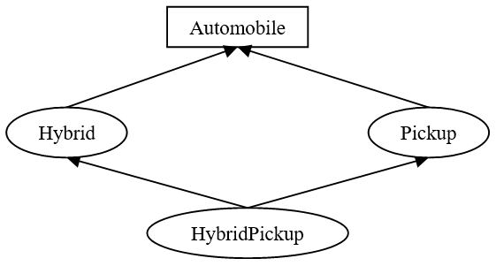
16.2.4 Inheritance – Diamond
Both Hybrid and Pickup would be comprised of the attributes of the Automobile class
HybridPickup contains multiple copies of Automobile attributes, causing a problem
Solution will depend upon the language being used

Slide 15
16.2.4 Inheritance – Relationships
Two relationships in OOP that are crucial in describing the interaction of classes
Specialization
Sometimes referred to as an is-a relationship
A Pickup “is-a” Automobile
A Duck “is-a” bird
A Student “is-a” Person
Containment, aggregation, or composition
Often referred to as has-a relationship
Automobile “has-a” Engine
Automobile class contains an instance of the Engine class
Notes:
Remember: A “has-a” relationship refers to containment. A “is-a” relationship refers to inheritance.

Slide 16
16.2.5 Polymorphism
Polymorphism
Ability of similar objects (implies inheritance) to respond differently to the same message
Sending the same Start message to a Pickup or a Hybrid
Starts either vehicle even though the process is different
With polymorphism we don’t need to know what type of object we are dealing with, the correct Start will be called

Slide 17
16.3.1 Models Real Life
OOP makes it easy to represent or model our world
Many things around us can be thought of as an object
Coffee cup
Has attributes that determine its size, shape, color and contents
Includes useful methods for manipulating the object, Fill, Sip, and Guzzle
Ability to model the world is an important advantage of OOP, especially in industries like gaming or simulation

Slide 18
16.3.2 Self Contained – Well Designed Objects
Well designed objects manipulate the data or state of an object by passing messages through the object’s interface
Objects must stand on their own, be self-contained
State of the object’s variables should be known
Methods that manipulate or alter data members (mutators), insure data stored is valid
Example
The size attribute in the Engine example should never be negative
Mutators
Methods that change the data members of a class

Slide 19
16.3.2 Self Contained – Best Practices
Initialization of variables guarantees the object is originally set to a known state
Always prefer initialization to assignment (PITA)
It is the producer’s responsibility to always ensure the state of the data is valid
Controlling an object through its interface guarantees it behaves in a safe manner and has a valid state
Number of cylinders in an Engine cannot be negative
Only allowing the consumer to access data members through a mutator ensures this valid state

Slide 20
16.3.3 Code Reuse – Description
Often possible to reuse objects in other applications
Engine class developed for an Automobile could be used by a Boat class for those boats that contain an engine
To reuse classes
Design and implement classes with reusability in mind
As a producer, create a simple and flexible interface

Slide 21
16.3.3 Code Reuse – Generic Programming
Generic programming
Allows programmer to specify a class contains data members whose type changes to meet a variety of needs
In C++ templates are used to implement generic programming
For example, we could create a container of information called a DynamicArray
Create the container so it can contain any form of data
Integers, Automobiles, or Pickups
No need to change container to handle different data types

Slide 22
16.3.4 OOP Overhead
Extra layer of abstraction often makes program executables developed using OO methodologies bigger
Environments with limited resources may find overhead of OOP prohibitive (i.e., embedded systems)
By understanding what’s happening under the hood with C++, we can minimize the overhead costs of our programs

Slide 23
16.4 String Class – Description
Predefined string class includes many of the components of OOP just discussed
Acts as a wrapper around a dynamic cString
Wrapper
Implies the cString is encapsulated within string class
Access the cString through its interface provided by the string class
Include <string> header file and follow namespace rules
Notes:
Remember: Use the <cstring> header file to access predefined cString functions. The <string> header file is only used to access the string class.

Slide 24
16.4.1 Instantiation and Initialization – Example
Instantiated the same as any primitive type
Instantiation is an OOP term that means variable declaration
#include <string> // Allow access to the string class
using std::string; // Follow namespace rules
string full_name;
string fname = "Tim";
string lname ( "Wheeler" );
string aka{ "Wimpy" };
string students[25];

Slide 25
16.4.1 Instantiation and Initialization – Explanation
Encapsulated in the string class is a cString data member
Dynamically allocated and assigned a value during the instantiation process
If not initialized, the string class insures its data member is initialized to an empty string
Printing a non-initialized string displays nothing, rather than the undetermined results displayed from a non-initialized cString

Slide 26
16.4.2 Reading and Writing Strings – Using cin and cout
Includes functionality to use cin and cout with its objects
Accomplished by overloading the insertion and extraction operators to work with strings
Overloading
Process of providing alternate definition for a function or an operator
cout << "Enter your first name: ";
cin >> fname;
cout << "Enter your last name: ";
cin >> lname;
cout << "Hello " << fname << " " << lname << "!" << endl;

Slide 27
16.4.2 Reading and Writing Strings – Using getline
Can not use .getline member function with strings
Instead, use getline non-member function
cout << "Enter your full name: ";
cin.ignore ( cin.rdbuf ( )->in_avail ( ) );
getline ( cin, full_name );
cout << "Hello " << full_name << endl;
There is no need to flush the buffer or clear the error flags after the call to getline
Those statements were needed in case the user entered too many characters at the keyboard
This version of getline does not have a maximum number of characters to read

Slide 28
16.4.3 Other String Features
strings don’t use cString functions like strcpy or strcat to manipulate the string
full_name = fname;
full_name += " " + lname;
if ( full_name == "Tim Wheeler" )
cout << "Let's go fishing!" << endl;
cout << "There are " << full_name.length ( )
<< " characters in " << full_name << endl;
Assignment operator can be used instead of strcpy
+ and += operators replace strcat
strcmp is not necessary because comparison operators can be used with strings
A lot of other functions available
Only way to manipulate data stored is through the interface
// Output
Let's go fishing!
There are 11 characters in Tim Wheeler

Slide 29
16.5 UML Introduction
Unified Modeling Language (UML)
Includes standardized symbols for developing, documenting, and modeling a software system or application
Language independent

Slide 30
16.5.1 UML Overview
Introduced in mid 1990’s by Grady Booch and Jim Rumbaugh and continues to evolve
Diagrams for modeling
Use Cases
Class Diagrams (our focus)
Sequence Diagrams
State Diagrams
And many more

Slide 31
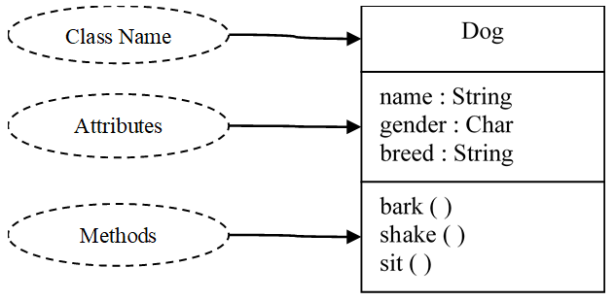
16.5.2 Class Diagrams – Description and Example
Illustrates classes and their relationships
Symbols used
Box that includes name of the class in the top section
Below the name an optional compartment containing the attributes of the class
Final section contains the class's operations or methods

Slide 32
16.5.2 Class Diagrams – Importance
Developing class diagrams not always an easy task
Allows the developer and the users to quickly see the major characteristics associated with a class
UML continues to gain widespread acceptance

Slide 33
16.7 C The Differences
This chapter presented OOP from a broad perspective, without any references to a specific language
C++ includes a number of extensions over C making it much easier and faster to write OO programs
When doing OOP, C++ would usually be your first choice over C

