Slide 1
Chapter 18 Introduction to Linked Lists

Slide 2
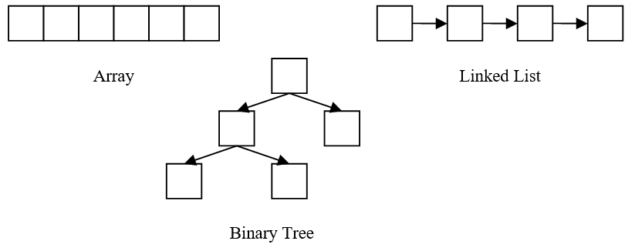
18.1 Data Structures – Definition
Data structure
Method for storing data so information can be used in an efficient manner
Some common data structures are shown below

Slide 3
18.1 Data Structures – Comparison
An array
Is a data structure
Made up of a contiguous block of memory
Allows any element to be randomly accessed
Elements of a linked list are accessed sequentially
Binary tree stores information in a hierarchical form
Data structure is simply a container for information

Slide 4
18.2 Linked Lists – Analogy
Similar to a passenger train
Locomotive at the beginning followed by a number of cars
Each car is coupled together
At the end there is, sometimes (not very often anymore), a caboose
To visit somebody in the last car, need to walk through all the other cars
Contain nodes (cars) that hold information (people) and are connected (coupled) to the next node by a pointer
Front of the list is marked by the head pointer (locomotive)
End of the list could optionally be marked by a tail pointer (caboose)
Last node’s pointer will be set to null to signify there are no other nodes (no more cars)
To get to the last node, have to go through all other nodes (a linked list is accessed sequentially)

Slide 5
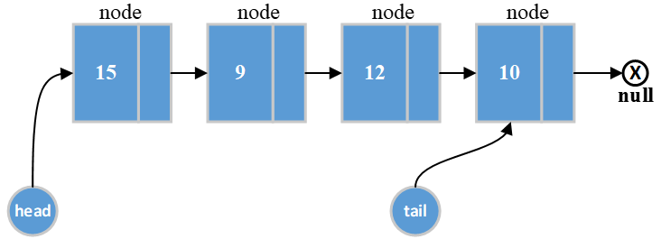
18.2 Linked Lists – Diagram

Slide 6
18.2.1 List Implementation Options
A node can either be a structure or a class
Using only structures is common when using the procedural paradigm
Typical OOP methodology
Node class
Contains data as well as the pointer to the next node
Linked list class
Contains the head pointer, optional tail pointer, and the functions necessary to manipulate the linked list
Doubly linked list
Another alternative that keeps a pointer to the previous node as well as the next node
Valuable because allows the ability to traverse the list in both directions

Slide 7
18.2.2 Node Class
In the example below, since the pointer must contain an address of another Node, the m_next pointer is declared as a Node pointer
A pointer embedded in a structure or class that has the same target type as the UDT in which it is enclosed, is called a self-referential pointer
#include "Person.h"
class Node
{
public:
Node ( Person data );
Person getData ( );
Node * getNext ( );
void setData ( Person data );
void setNext ( Node * next );
private:
Person m_data;
Node * m_next;
};

Slide 8
18.2.3 Head Pointer – List class Definition
The head pointer will hold the address of the first node
This pointer is declared inside of the List class definition
#include "Node.h"
class List
{
public:
List ( );
List ( const List & copy );
List & operator = ( const List & rhs );
~List ( );
private:
Node * m_head;
};
The List class contains the m_head pointer
All four of the main manager functions will also be included
Since List has a pointer as a data member, it is crucial all of these methods are implemented
It is also advisable that you don’t provide a getter or setter for m_head
Notes:
Remember: Not all data members need to have setters and getters. In the case of linked lists, it is an extremely dangerous thing to do. Your List class has the responsibility to maintain and protect the head pointer. Allowing outside functions to manipulate or modify the head pointer will cause instability in your list.

Slide 9
18.2.3 Head Pointer – List Default Ctor
It is important m_head be initialized to null
Not doing so will cause difficulties determining if the list is empty
Because of the initialization, the list can be determined to be empty whenever m_head is null
Initialization of data members is the job of the constructor
List::List ( ) : m_head ( nullptr )
{ }

Slide 10
18.2.4 Creating a New Node
Before a node can be inserted into the list, a new node needs to be dynamically allocated
The Node constructor’s task is to initialize the m_data data member and, most importantly, m_next to nullptr
Node::Node ( Person data ) : m_data ( data ), m_next ( nullptr )
{ }
The actual dynamic allocation of the Node is done in the individual function(s) that insert into the List
Notes:
Remember: The next pointer of the last node always needs to contain a null. This allows the programmer to know when the end of the list has been encountered.

Slide 11
18.3 Prepending a Node – Algorithm
Before inserting a new node, first determine where in the list the node is to be placed
Three options include inserting the new node at
Head of the list (prepending)
End of the list (appending)
Somewhere in between head and tail (ordered)

Slide 12
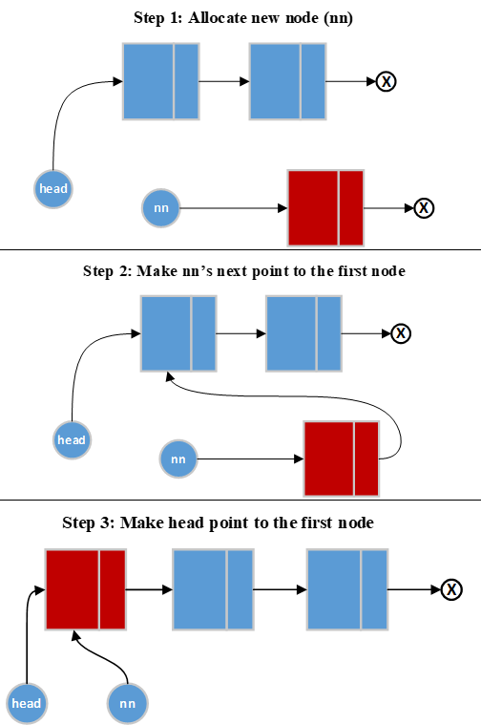
18.3 Prepending a Node – Diagram and Explanation
Prepend ( data )
Allocate a new node
Call new_node's setNext method passing head
Assign new_node to head
The Prepend function creates a new node and then calls the setter in Node to set the next pointer to m_head
What would happen if we tried to prepend to an empty list?
If the list is empty, m_head is null
Therefore, null is assigned to the new node’s next pointer guaranteeing the integrity of our one node list

Slide 13
18.4 Appending a Node – Algorithm
Appending would be very simple task if keeping a tail pointer
Can be performed when there is only a head pointer
Like with Prepend function, a node should be able to be appended to the end of an empty list
Traveling pointer
Used to traverse the list in order to find the end

Slide 14
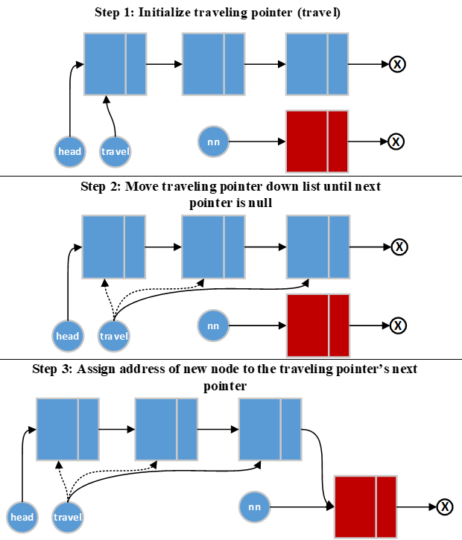
18.4 Appending a Node – Diagram and Pseudocode
Append ( data )
Create the new node
If head is null
Assign new_node to head
Else
Assign head to a traveling pointer
While travel's next is not null
travel = travel's next pointer
End Loop
Assign new_node to travel's next
End If

Slide 15
18.4 Appending a Node – List Copy Ctor
Where would Append be useful?
The Prepend is much more efficient because the algorithm doesn’t require traversing to the end of the list
What about the copy constructor and copy assignment operator?
You will need to make a copy of the list for both functions
Assign copy's head to a traveling pointer
While travel is not equal to null
Call Append for THIS object passing travel's data
travel = travel's next pointer
End While

Slide 16
18.5 Inserting a Node into an Ordered List – Description
Last option for inserting a node involves placing it into the middle of a list
Usually arises when placing a node in an ordered list
Ordered list
Each node is placed into the list in a specified order
The list is always ordered
Sorted list
Places nodes at the beginning or end of the list and then a sorting algorithm is applied to the list

Slide 17
18.5 Inserting a Node into an Ordered List – Algorithm
When inserting a node there are four situations that need to be handled
The list is empty
New node is placed before the current head
New node is to be placed at the end of the list
New node placed between two existing nodes
First three situations addressed in previous slides
Algorithm presented introduces the concept of a trailing pointer
Trailing pointer
Trails one node behind the traveling pointer

Slide 18
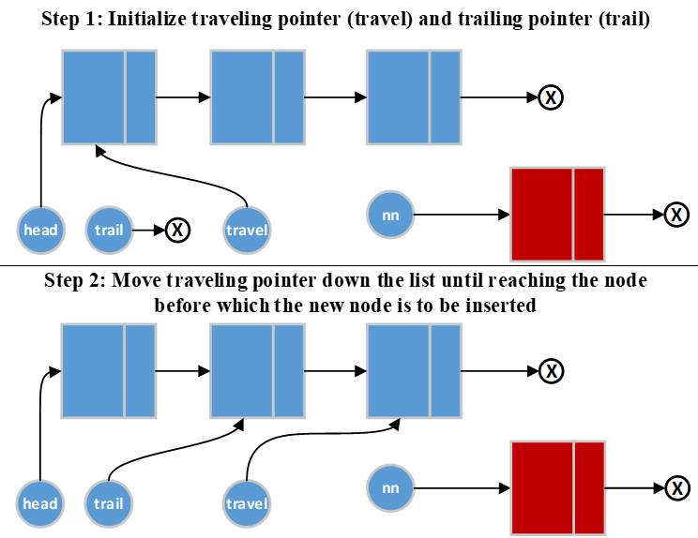
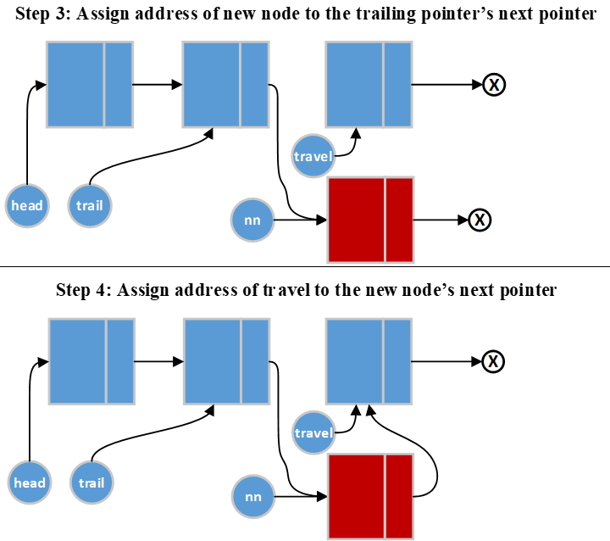
18.5 Inserting a Node into an Ordered List – Diagram

Slide 19
18.5 Inserting a Node into an Ordered List – Pseudocode
InsertOrdered ( data )
Create the new node
If head is null or new_node's key value <= head's key value
Assign head to new_node's next
Assign new_node to head
Else
Initialize a traveling pointer to head
Initialize a trailing pointer to null
While travel is not null and travel's key < new_node's key
trail = travel
travel = travel's next pointer
End Loop
Assign new_node to trail's next pointer
Assign travel to new_node’s next pointer
End If
Notes:
Note: Can take care of multiple situations in each section of an if statement. The if itself handles situations 1 and 2. The else handles situations 3 and 4

Slide 20
18.5 Inserting a Node into an Ordered List – Potential Problem
Also crucial to understand the while loop shown in the pseudocode on the previous slide
Notice in the pseudocode below the conditions have been reversed from the pseudocode
While travel's key < new_node's key and travel is not null
Both loops appear to work the same
The loop on this slide causes the program to crash if inserting a node at the end of the list
When inserting at the end, the traveling pointer becomes null
Therefore, trying to access the data members of the traveling pointer causes the program to crash with a memory access violation
So how does the loop in pseudocode work?
C++ performs short circuit evaluation meaning as soon as the outcome of a condition can be determined, no additional pieces of the condition will be examined
If the traveling pointer is null, the part of the condition that accesses the data member of the traveling pointer is not evaluated

Slide 21
18.6 Traversing the List – Display Function
Lists are sequential
Necessary to start at the front of the list
Already shown how to traverse through a list using a traveling pointer to get to a specific location
Can take this concept and use it to display the contents of a list as shown below
void List::Display ( )
{
Node * travel = m_head;
while ( travel != nullptr )
{
cout << travel->getData ( ).getName ( ) << ' '
<< travel->getData ( ).getAge ( ) << endl;
travel = travel->getNext ( );
}
}

Slide 22
18.6 Traversing the List – Redundant Code
As shown in previous example, there would be a lot of overlapping code for any function traversing the list
Make it better by passing a function pointer that will be called to perform the action required of the traversal
Following example shows a traversal that performs the action by calling a function via a function pointer

Slide 23
18.6 Traversing the List – Traverse Function
Same basic traversal algorithm is used when performing any action on all nodes of the list as shown below
void List::Traverse ( void ( *visit ) (Person) )
{
Node * travel = m_head;
while ( travel != nullptr )
{
visit ( travel->getData ( ) );
travel = travel->getNext ( );
}
}
int main ( )
{
List friends;
...
friends.Traverse ( Display );
return 0;
}
void Display ( Person temp )
{
cout << temp.name << ' '
<< temp.age << endl;
}

Slide 24
18.6 Traversing the List – TraverseRecursive Function
void List::TraverseRecursive ( Node * head, void ( *visit ) (Person) )
{
if ( head != nullptr )
{
visit ( head );
TraverseRecursive ( head->next, visit );
}
}
So why do this recursively when there is so much more overhead?
Simply swapping the two lines in the if statement displays the list in reverse order

Slide 25
18.6 Traversing the List – Public TraverseRecursive Function
Notice in the previous example, that head is passed into the Traverse function
It makes sense that the initial call would need to be passed m_head
Functions outside of the class shouldn’t don’t have access to m_head
Common solution creates two functions with the same name
The first function is public and only accepts one parameter
// Public
void List::TraverseRecursive( void(*visit)( Person ) )
{
TraverseRecursive( m_head, visit );
}
The second function is the one shown in the previous slide, and is made private
Only functions that have access to m_head, class methods, can call it with the appropriate parameters

Slide 26
18.7 Deleting nodes
Most important deletion activity is to destroy or purge the list
If not done, the program contains a multitude of memory leaks

Slide 27
18.7.1 Deleting All Nodes – Description
Purge function should be called prior to the program exiting
Used to remove all of the nodes and return the list back to its original state
Initial thought is to have the Purge function be the List destructor
Having a separate function that is called from the dtor as well as other functions like the op = is extremely useful
It also provides important functionality to the consumer
Always assign null to head when this function is done
In the pseudocode on the next slide, when the function is done head will be null, thus resetting the head pointer to an empty list state
Notes:
Remember: When dynamic memory is deallocated, the pointer doesn’t change even though the address in the pointer is no longer valid.

Slide 28
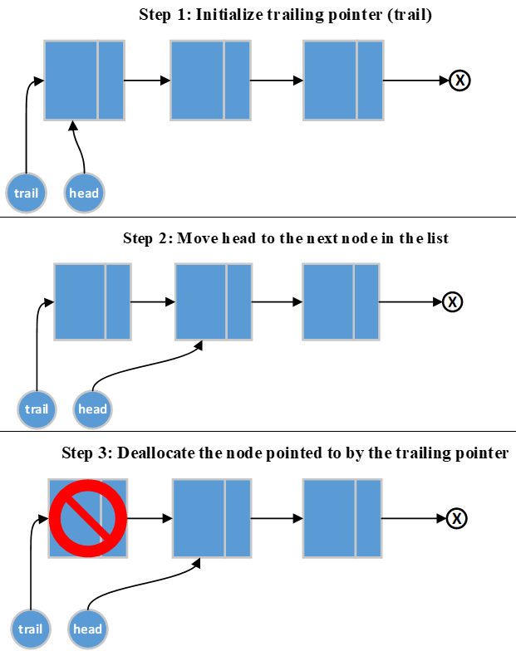
18.7.1 Deleting All Nodes – Diagram and Pseudocode
Purge ( )
While head is not null
Assign head to trail
head = head's next pointer
Deallocate trail
End Loop

Slide 29
18.7.2 Deleting a Specific Node from an Ordered List – Algorithm
Five situations must be handled when deleting a specific node
List is empty
Node to be deleted is head
Node to be deleted is the last node in the list
Node to be deleted is between two nodes
The information to be deleted doesn’t exist in the list
Deleting from an empty list and attempting to delete a node that doesn’t exist are error situations
Need to handle according to the program specifications
Next slide illustrates the issue of deleting a node from between two nodes
Deleting head was addressed previously

Slide 30
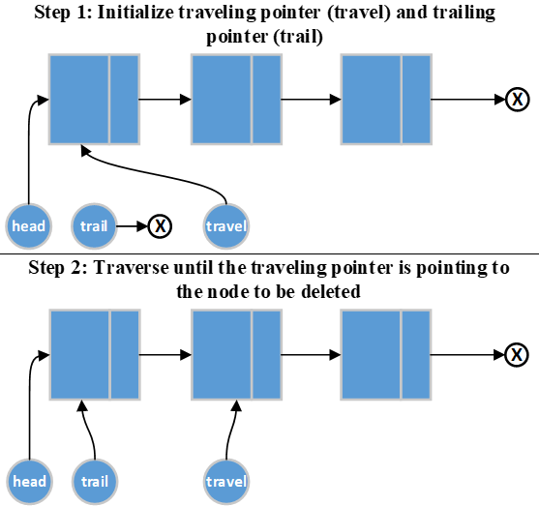
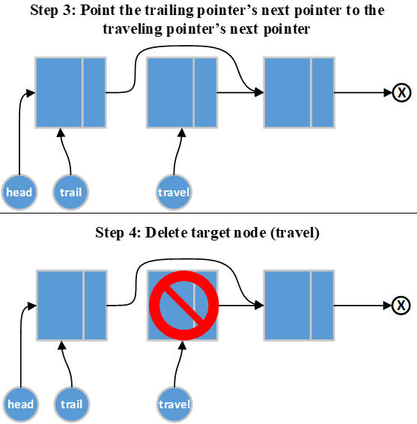
18.7.2 Deleting a Specific Node from an Ordered List – Diagram

Slide 31
18.7.2 Deleting a Specific Node from an Ordered List – Pseudocode
DeleteNode ( target key passed by value )
If list is empty
Handle deleting from empty list error
Else If head's key is equal to target value
Assign head to trailing pointer
head = head's next pointer
delete trail
Else
Assign head to traveling pointer
While travel not null and travel's key is not equal to target
Assign travel to trailing pointer
travel = travel's next pointer
End Loop
If traveling pointer is null
Handle target not found error
Else
trail's next pointer = travel's next pointer
delete travel
End If
End If

Slide 32
18.8 Arrays Versus Linked Lists – Comparisons
 | Arrays | Dynamic Arrays | Linked Lists
Access | Random and sequential | Random and sequential | Sequential
Memory usage | Static size | Dynamic | Dynamic
Extra memory required | None | None | An extra pointer for each node
Efficiency of adding new element | N/A | Poor | Excellent
Efficiency of deleting an element | N/A | Poor | Excellent
Searching algorithms | Binary or linear | Binary or linear | Linear
Efficiency of ordering elements | Good | Good | Excellent if using an ordered list, otherwise poor

Slide 33
18.8 Arrays Versus Linked Lists – Summary
If elements are frequently added to the data structure, a linked list is the better choice
If the size of the data structure is to remain the same and number of elements is known at compile time, an array is a good choice
Dynamic arrays are good for where the number of elements will not change, or change very little, but the number of elements isn’t known until runtime
Bottom line
The data structure to use is determined by the situation

Slide 34
18.10 C The Differences
In C, replace the classes with structures and have external functions for the list operations
Conceptually though, a linked list implementation doesn’t change much when using other languages

